Slide 1




Data infrastructure to create the future we want
Or
How can we be better ancestors?
Copyright Centre for Digital Built Britain, on behalf of the Chancellor, Masters and Scholars of the University of Cambridge, 2021. All Rights Reserved.

Slide 2
Running order
Our Vision for the Built Environment
What is the Built Environment?
What is a digital built Britain?
Digital twins
What is a national digital twin?
The national digital twin programme
Why is this important?

Slide 3

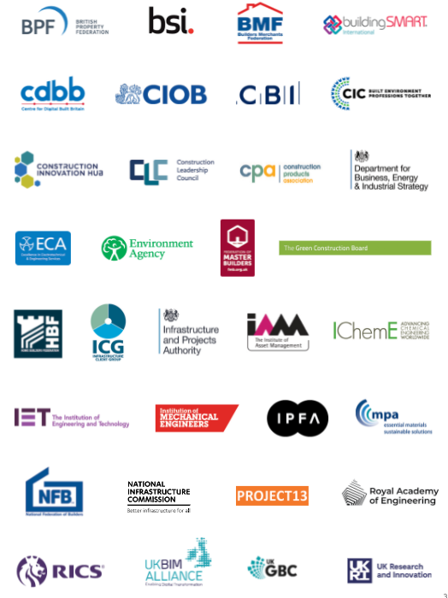
Who we are

Slide 4
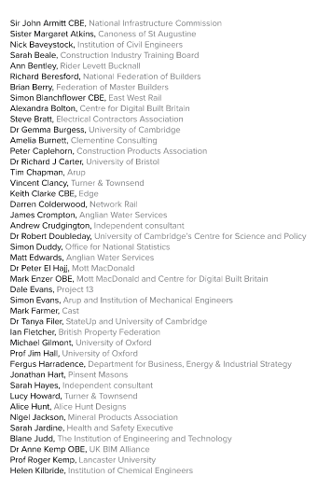
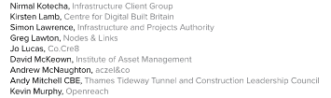
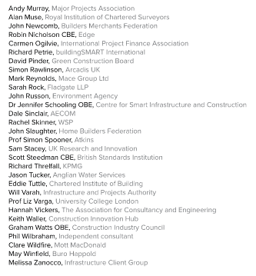
Acknowledgements

Slide 5
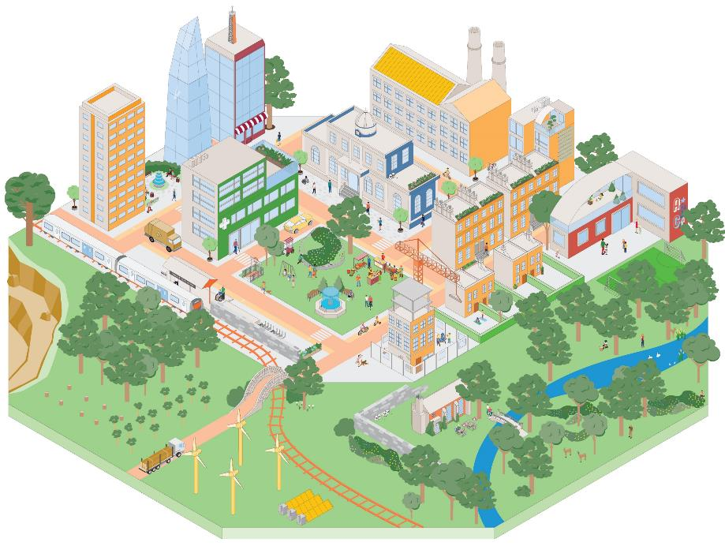
The Vision
Our Vision is for a built environment whose explicit purpose is to enable people and nature to flourish together for generations
It is only when we shift our focus from creating the built environment to the outcomes enabled by it that people and nature can thrive together for the generations to come
The built and natural environments are complex and interconnected systems that are essential for our wellbeing
Improving outcomes for people and nature depends on the services that these systems provide and on coordinating the built environment as a whole, not just as individual parts

Slide 6
Why now
The built environment is too big to ignore
The greatest challenges of our generation are systemic and interdependent
The pandemic has emphasised important realities:
        Wellbeing is crucial
        Decisions have long-term consequences
        Change can happen quickly
        We need to get more from less

Slide 7
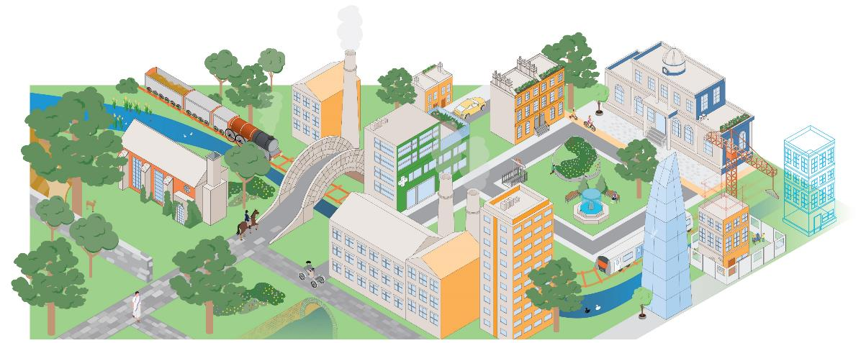
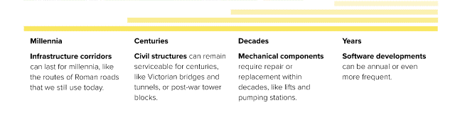
Why now - Choices in the built environment can last for generations

Slide 8
Why is it important?
Unborn
generations
6.75 trillion
The dead
100 billion
The living
7.7 billion
Looking 50,000 years in to the past and 50,000 into the future - assuming that the 21st Century’s birth rate remains constant - all human lives are far outweighed by those to come
Based on UN estimate that average births per year in the 21st Century will stabilise at 135 million

Slide 9
The built environment as a system of systems
Copyright Centre for Digital Built Britain, on behalf of the Chancellor, Masters and Scholars of the University of Cambridge, 2021. All Rights Reserved.

Slide 10
System processes and asset lifecycles
Copyright Centre for Digital Built Britain, on behalf of the Chancellor, Masters and Scholars of the University of Cambridge, 2021. All Rights Reserved.

Slide 11
Interventions on the system of systems
Copyright Centre for Digital Built Britain, on behalf of the Chancellor, Masters and Scholars of the University of Cambridge, 2021. All Rights Reserved.

Slide 12
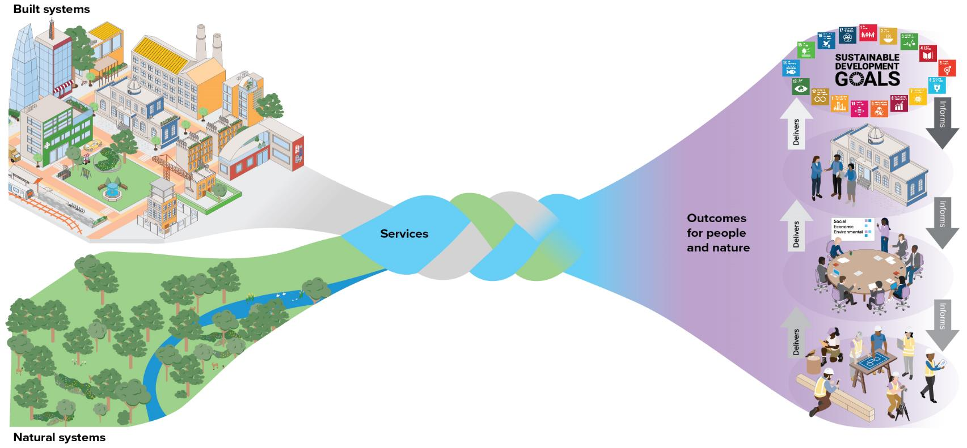
Services - the connection between the outcomes we desire and the systems we use to achieve them

Slide 13
Cyber-physical system
Data
Interventions
Copyright Centre for Digital Built Britain, on behalf of the Chancellor, Masters and Scholars of the University of Cambridge, 2021. All Rights Reserved.

Slide 14

Working in partnership with industry, government and academia to develop a digital built environment that improves quality of life for all.

Slide 15
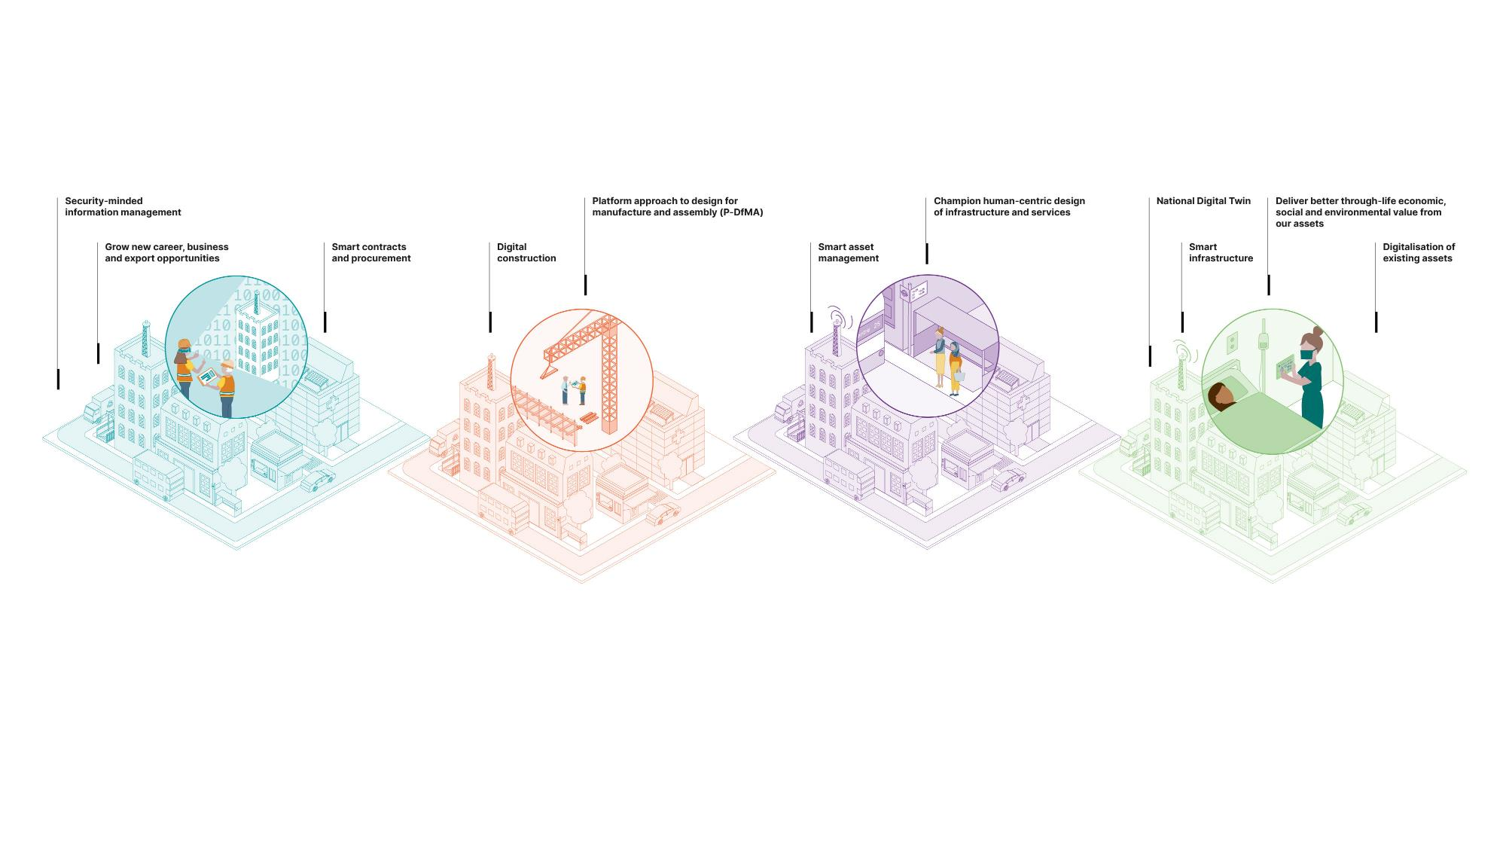
This is digital built Britain
Design
Use best practice, secure by default, information management and digital techniques to get data right from the start and design better-performing homes, buildings and infrastructure.
Build
Exploit new and emerging
digital construction, information management, and manufacturing technologies to improve safety, quality and production during construction.
Operate
Use effective information management to transform the performance of the
built environment and the services it delivers.
Integrate
Understand how the built environment can improve citizen’s quality of life and use that information
to drive the design and build of our economic
and social infrastructure and the operation an integration of the services they deliver.
Copyright Centre for Digital Built Britain, on behalf of the Chancellor, Masters and Scholars of the University of Cambridge, 2021. All Rights Reserved.

Slide 16
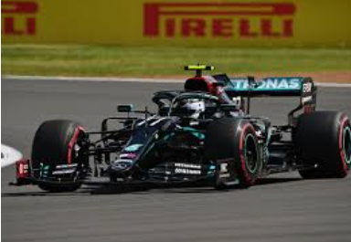
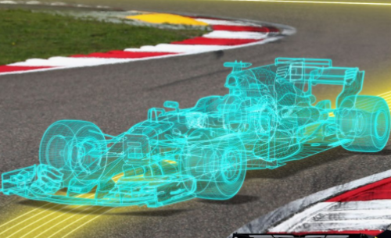
Digital twins
Physical
Twin
Data
Digital
Twin
Insights
Outcomes
Interventions
Decisions
Copyright Centre for Digital Built Britain, on behalf of the Chancellor, Masters and Scholars of the University of Cambridge, 2021. All Rights Reserved.

Slide 17
Digital twins
Delivering value: “better decisions faster”
Assets
Processes
Systems
Physical
Twin
Data
Digital
Twin
Data
Models
Visualisation
Interventions
Driven by values: purpose, trust and function
Copyright Centre for Digital Built Britain, on behalf of the Chancellor, Masters and Scholars of the University of Cambridge, 2021. All Rights Reserved.

Slide 18
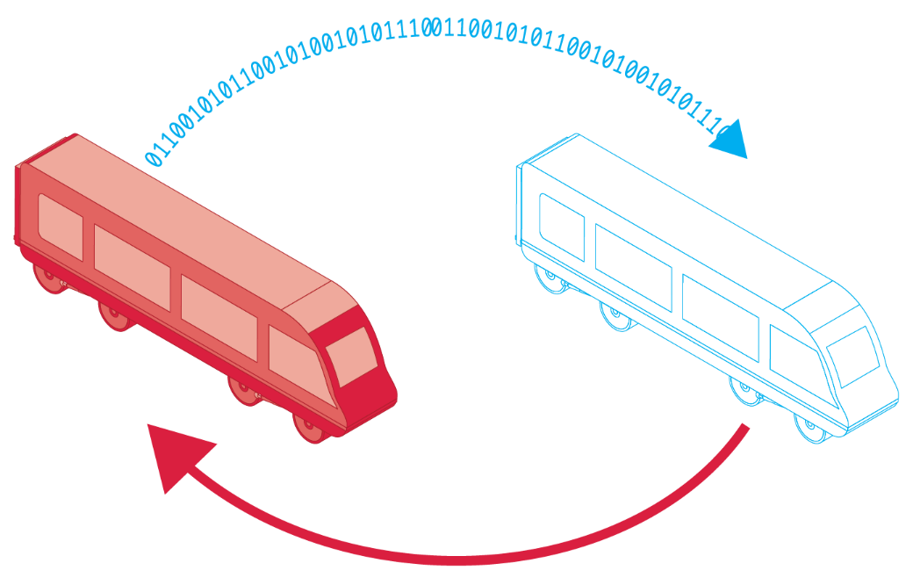
Digital twins
Data
Physical twin
Insights
Decisions
Outcomes
Digital twin
Interventions
Copyright Centre for Digital Built Britain, on behalf of the Chancellor, Masters and Scholars of the University of Cambridge, 2021. All Rights Reserved.

Slide 19

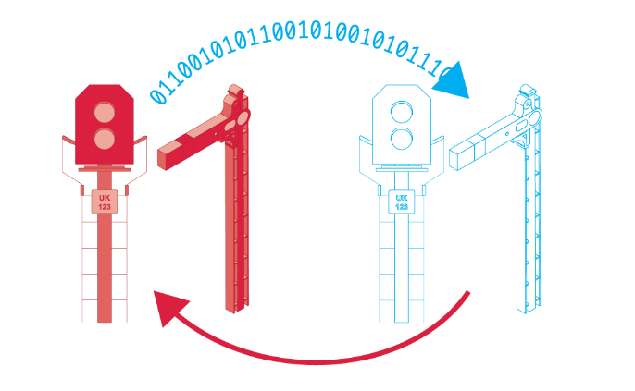
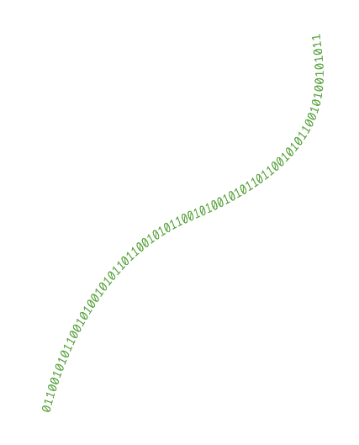

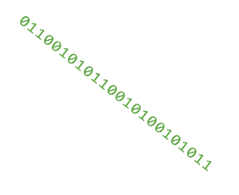
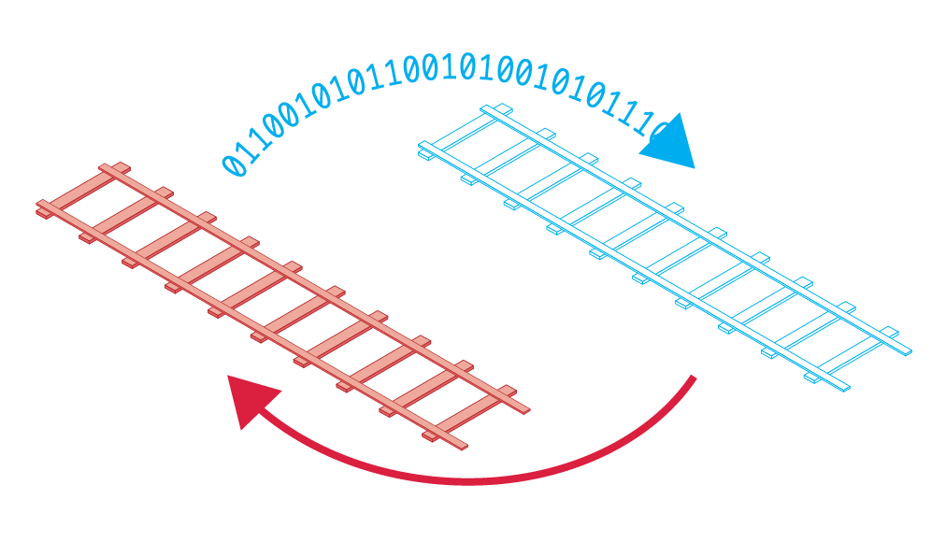
Connected digital twins
Copyright Centre for Digital Built Britain, on behalf of the Chancellor, Masters and Scholars of the University of Cambridge, 2021. All Rights Reserved.

Slide 20
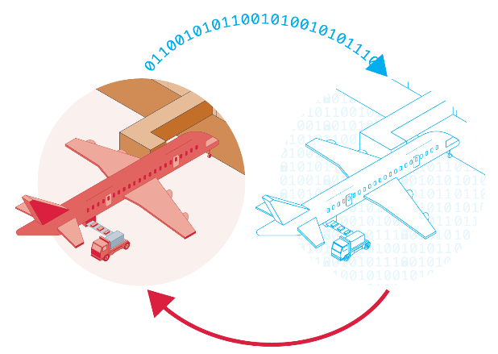
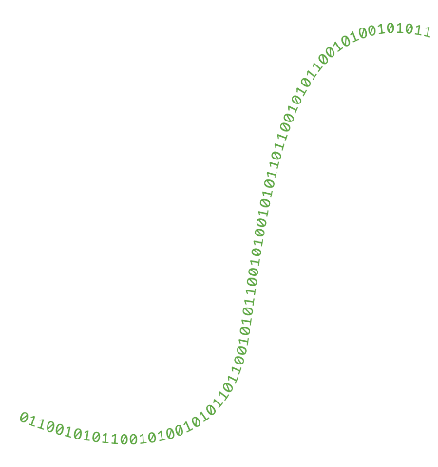
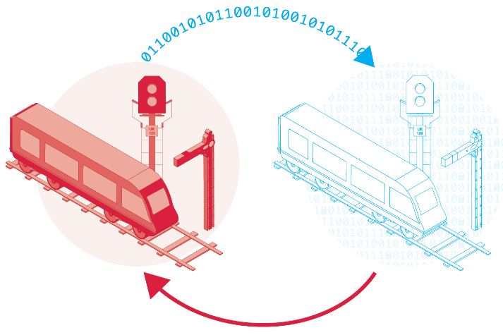
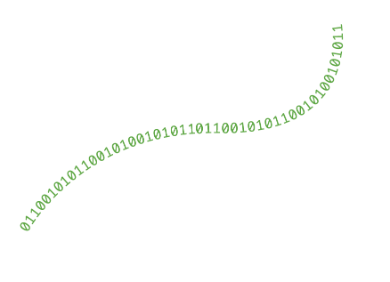
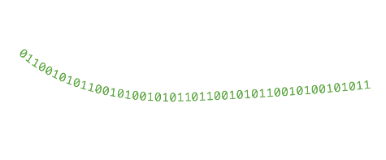
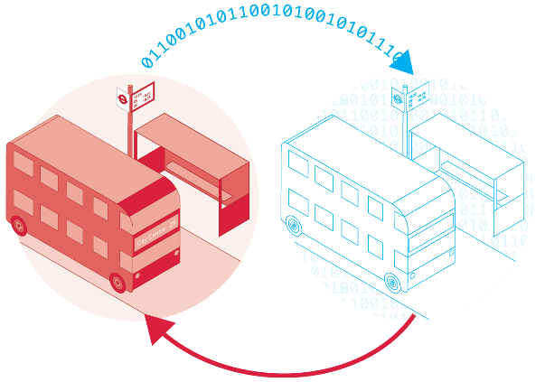
Ecosystem of connected digital twins
Copyright Centre for Digital Built Britain, on behalf of the Chancellor, Masters and Scholars of the University of Cambridge, 2021. All Rights Reserved.

Slide 21
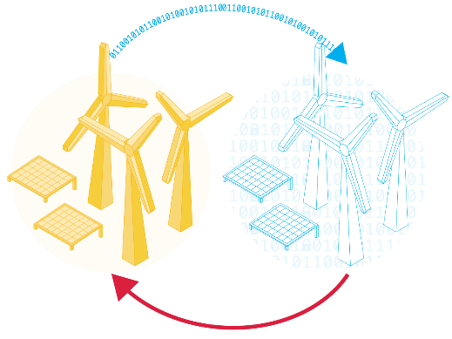

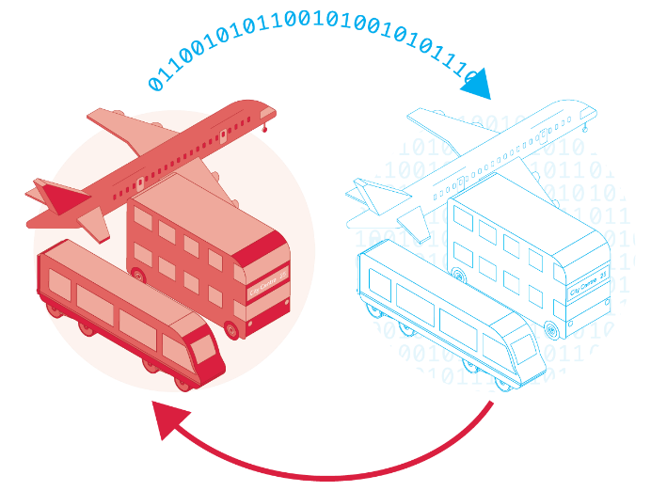
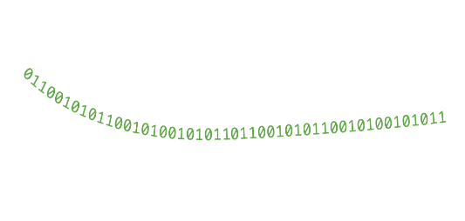
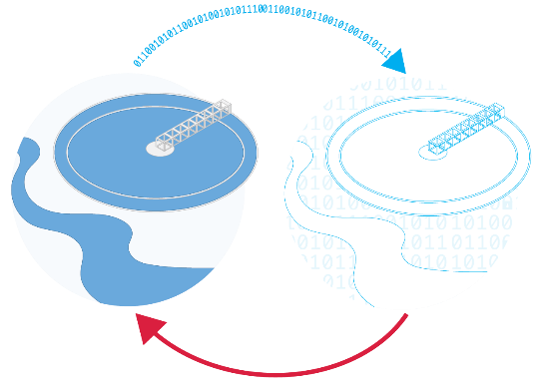
Ecosystem of connected digital twins
Copyright Centre for Digital Built Britain, on behalf of the Chancellor, Masters and Scholars of the University of Cambridge, 2021. All Rights Reserved.

Slide 22

The pathway towards an Information Management Framework
    Foundation Data Model – a consistent, clear understanding of what constitutes the world of digital twins
    Reference Data Library – the particular set of classes and the properties we will want to use to describe our digital twins
    Integration Architecture – the protocols that will enable the managed sharing of data
Copyright Centre for Digital Built Britain, on behalf of the Chancellor, Masters and Scholars of the University of Cambridge, 2021. All Rights Reserved.

Slide 23
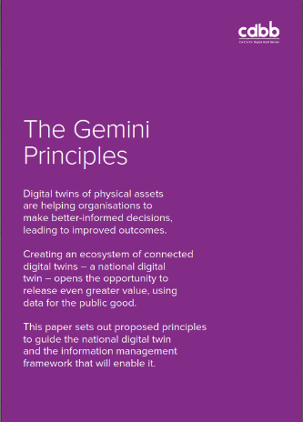
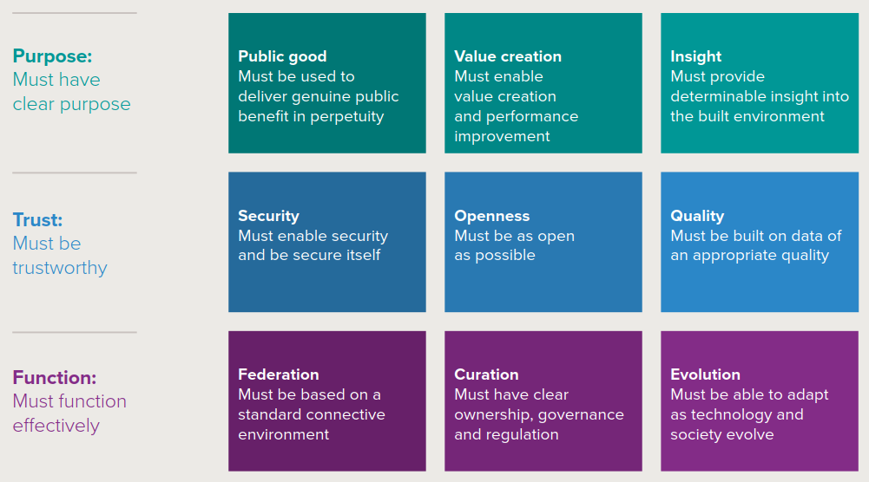
Driven by values
Copyright Centre for Digital Built Britain, on behalf of the Chancellor, Masters and Scholars of the University of Cambridge, 2021. All Rights Reserved.

Slide 24
A market-based approach
Digital Commons
Collaborate on the rules
Digital twin market
Compete on the game

Slide 25
The NDTp key projects for FY21/22
Community-led
bottom-up standards
Specialist-led
top-down standards
Learn by doing, progress by sharing
DT Hub
Information Management Framework
Collaborate on the rules, compete on the game
CReDo
Climate Resilience Demonstrator project
Tangible working example of the National Digital Twin working with CPC
Copyright Centre for Digital Built Britain, on behalf of the Chancellor, Masters and Scholars of the University of Cambridge, 2021. All Rights Reserved.

Slide 26
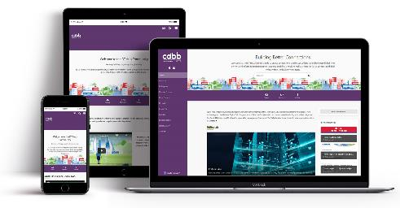
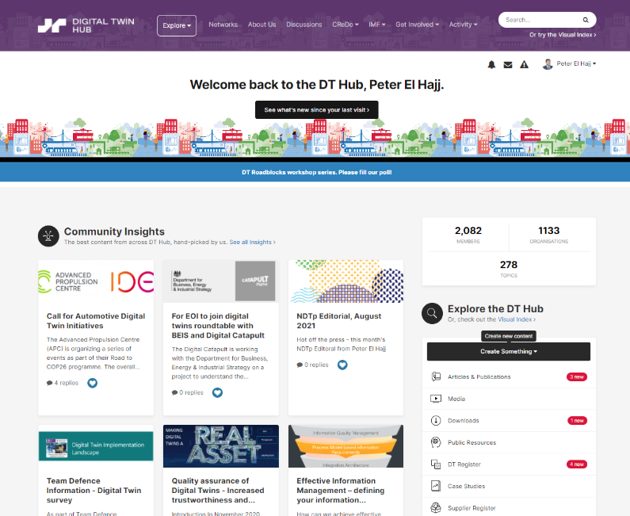

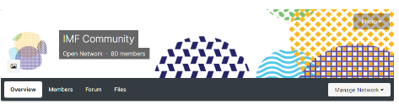
Digital Twin Hub
Learn by doing, progress by sharing
Established community
2100+ members
1000+ organisations
60+ Countries
Examples of existing content
Digital twin case studies
Digital twin toolkit
Media and events recordings
Digital twin register
Digital twin research register
Groups and networks
Articles and publications
Forums and networks
Glossary
Copyright Centre for Digital Built Britain, on behalf of the Chancellor, Masters and Scholars of the University of Cambridge, 2021. All Rights Reserved.

Slide 27
DT Hub community
Copyright Centre for Digital Built Britain, on behalf of the Chancellor, Masters and Scholars of the University of Cambridge, 2021. All Rights Reserved.

Slide 28
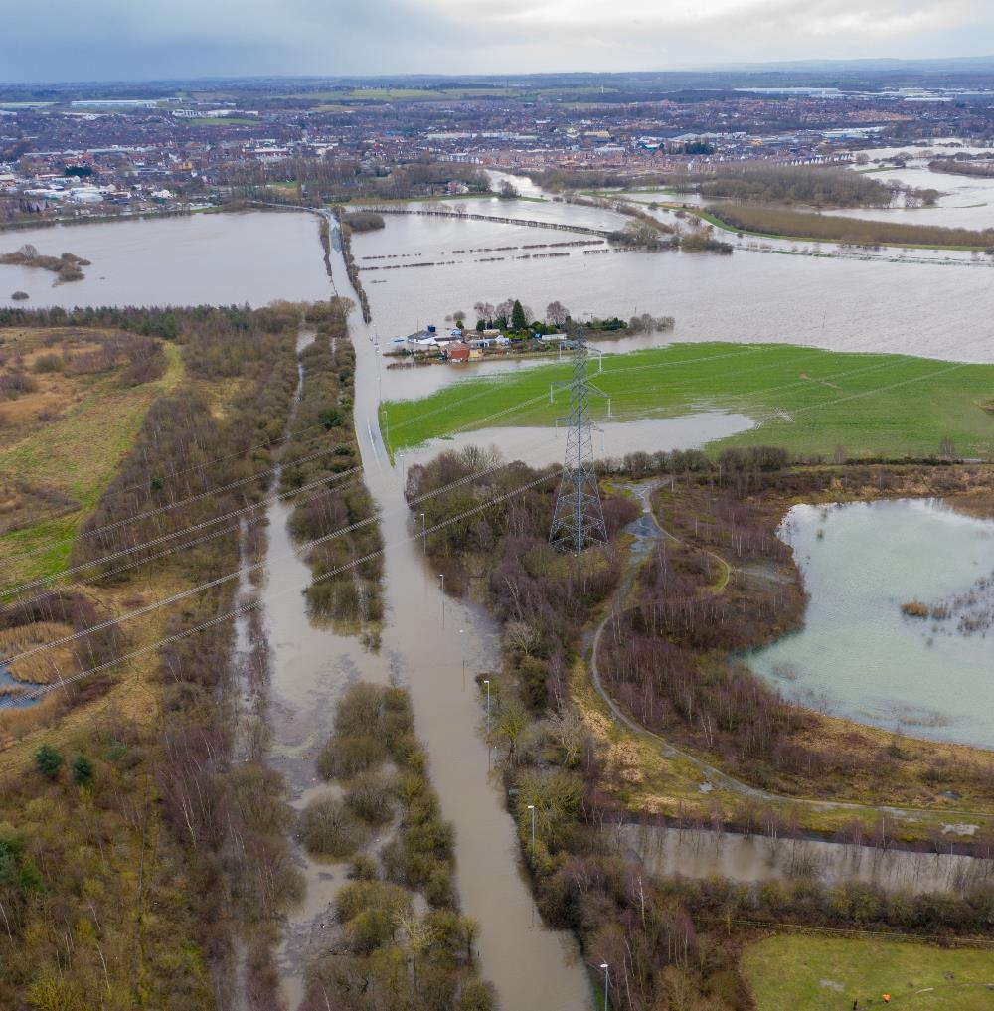
CReDo purpose
Climate change
Climate change is a systemic challenge that demands systems-based solutions. Cross-sector data sharing is an essential enabler of net-zero and climate resilience.
To demonstrate meaningful secure, resilient information flow across organisational and sectoral boundaries in the 'domain' of Climate Resilience for the water, energy and telecoms sectors.
DTs as an essential enabler of net zero
2. Information Management Framework (IMF)
To develop a tangible working example of the National Digital Twin - a 'thin slice' of the envisaged ecosystem of connected digital twins.
Apply Information Management Framework approach to achieve cross-sector interoperability.
Copyright Centre for Digital Built Britain, on behalf of the Chancellor, Masters and Scholars of the University of Cambridge, 2021. All Rights Reserved.

Slide 29
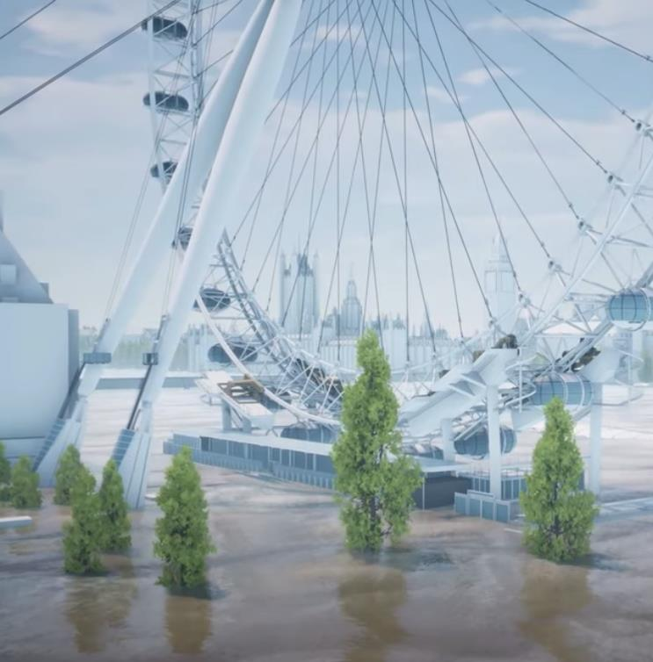
CReDo public demonstration
  Audiences
    Technical: it’s possible
    Domain: it’s meaningful
    Policy: it’s necessary
    Public: it’s imperative
  COP26 and wider dissemination
    Compelling public visual demonstration
    Film and interactive online demo
    Technical and non-technical papers
Copyright Centre for Digital Built Britain, on behalf of the Chancellor, Masters and Scholars of the University of Cambridge, 2021. All Rights Reserved.

Slide 30
Digital transformation and a national digital twin programme has to be a socio-technical change programme
Socio-
Technical
Copyright Centre for Digital Built Britain, on behalf of the Chancellor, Masters and Scholars of the University of Cambridge, 2021. All Rights Reserved.

Slide 31
Benefits of a National Digital Twin
Better decisions equal better outcomes for people and society
    Benefits to society: Improved stakeholder engagement. Better outcomes for the ultimate customers (the public – taxpayers/bill payers/fare payers/voters). Improved customer satisfaction and experience through higher-performing infrastructure and the services it provides.
    Benefits to the economy: Improved national productivity from higher-performing and resilient infrastructure operating as a system. Improved measurement of outcomes. Better outcomes per whole-life pound. Improved information security and thereby personnel, physical and cyber security.
    Benefits to business: New markets, new services, new business models, new entrants. Improved business efficiency from higher-performing infrastructure. Improved delivery efficiency, benefiting the whole construction value chain – investors, owners, asset managers, contractors, consultants, suppliers. Reduced uncertainty and better risk management.
    Benefits to the environment: Less disruption and waste. More reuse and greater resource efficiency – a key enabler of net zero and the circular economy in the built environment.
Copyright Centre for Digital Built Britain, on behalf of the Chancellor, Masters and Scholars of the University of Cambridge, 2021. All Rights Reserved.

Slide 32
Let’s remind ourselves why is it important?
Unborn
generations
6.75 trillion
The dead
100 billion
The living
7.7 billion
Looking 50,000 years in to the past and 50,000 into the future - assuming that the 21st Century’s birth rate remains constant - all human lives are far outweighed by those to come
Based on UN estimate that average births per year in the 21st Century will stabilise at 135 million

Slide 33
The digital transformation of the built environment must be
Outcome-focused
Purpose-driven
Systems-based
Values-guided
Socio-technical

Slide 34
The planet is ultimate system of systems
We can make Our Vision a reality, but only if we all play our part with energy, coordination and purpose, making use of the advanced array of enablers that we now have at our disposal.

Slide 35
Thank you
Build better connections: digitaltwinhub.co.uk
Copyright Centre for Digital Built Britain, on behalf of the Chancellor, Masters and Scholars of the University of Cambridge, 2021. All Rights Reserved.

