Slide 1
Data infrastructure for the future we want or… how to be better ancestors
Copyright Centre for Digital Built Britain, on behalf of the Chancellor, Masters and Scholars of the University of Cambridge, 2021. All Rights Reserved.

Slide 2
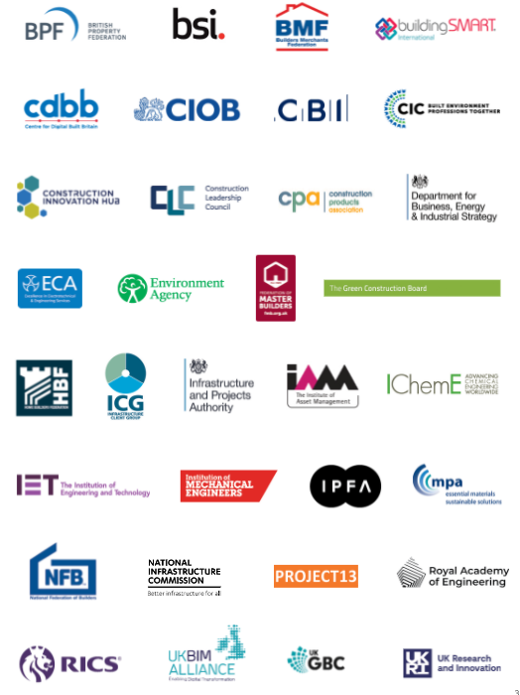
Who we are

Slide 3
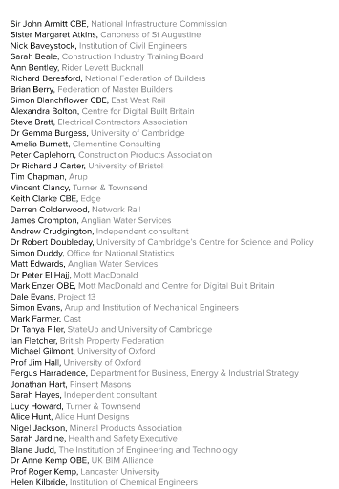
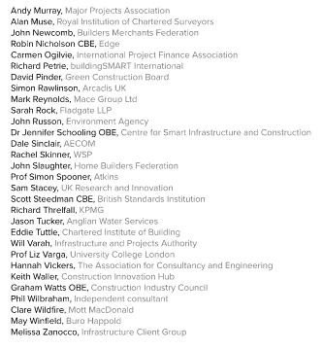
Acknowledgements

Slide 4
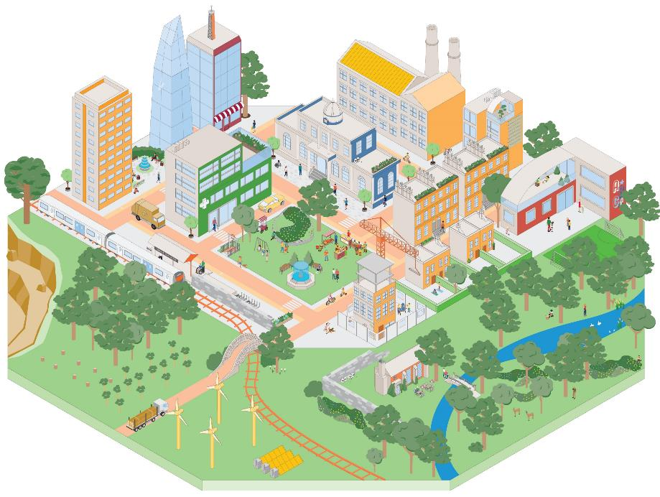
Our Vision
A built environment whose explicit purpose is to enable people and nature to flourish together for generations
It is only when we shift our focus from creating the built environment to the outcomes enabled by it that people and nature can thrive together for the generations to come
The built and natural environments are complex and interconnected systems that are essential for our wellbeing
Improving outcomes for people and nature depends on the services that these systems provide and on coordinating the built environment as a whole, not just as individual parts

Slide 5
Why now
The built environment is too big to ignore
The greatest challenges of our generation are systemic and interdependent
The pandemic has emphasised important realities:
Wellbeing is crucial
Decisions have long-term consequences
Change can happen quickly
We need to get more from less

Slide 6
Why now – Choices in the built environment can last for generations

Slide 7
Why is it important?
Unborn
generations
6.75 trillion
The dead 100 billion
The living 7.7 billion
Looking 50,000 years in to the past and 50,000 into the future - assuming that the 21st Century’s birth rate remains constant - all human lives are far outweighed by those to come
Based on UN estimate that average births per year in the 21st Century will stabilise at 135 million

Slide 8
The built environment as a system of systems
Copyright Centre for Digital Built Britain, on behalf of the Chancellor, Masters and Scholars of the University of Cambridge, 2021. All Rights Reserved.

Slide 9
System processes and asset lifecycles
Copyright Centre for Digital Built Britain, on behalf of the Chancellor, Masters and Scholars of the University of Cambridge, 2021. All Rights Reserved.

Slide 10
Interventions on the system of systems
Copyright Centre for Digital Built Britain, on behalf of the Chancellor, Masters and Scholars of the University of Cambridge, 2021. All Rights Reserved.

Slide 11
Services – the connection between the outcomes we desire and the systems we use to achieve them

Slide 12
Cyber-physical system
Data
Interventions
Copyright Centre for Digital Built Britain, on behalf of the Chancellor, Masters and Scholars of the University of Cambridge, 2021. All Rights Reserved.

Slide 13
Digital twins
Physical
Twin
Data
Digital
Twin
Insights
Outcomes
Interventions
Decisions
Copyright Centre for Digital Built Britain, on behalf of the Chancellor, Masters and Scholars of the University of Cambridge, 2021. All Rights Reserved.

Slide 14
Digital twins in the built environment
Delivering value: “better decisions faster”
Assets
Processes
Systems
Physical
Twin
Data
Digital
Twin
Data
Models
Visualisations
Interventions
Driven by values: purpose, trust and function
Copyright Centre for Digital Built Britain, on behalf of the Chancellor, Masters and Scholars of the University of Cambridge, 2021. All Rights Reserved.

Slide 15
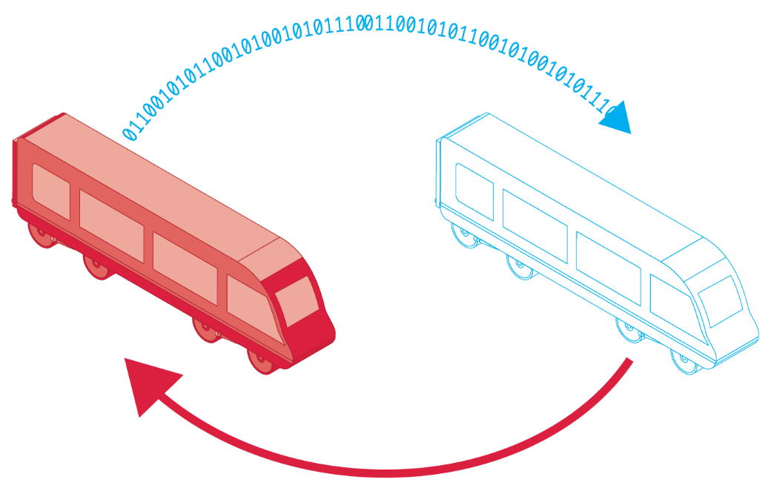
Digital twins
Data
Physical twin
Insights
Decisions
Outcomes
Digital twin
Interventions
Copyright Centre for Digital Built Britain, on behalf of the Chancellor, Masters and Scholars of the University of Cambridge, 2021. All Rights Reserved.

Slide 16
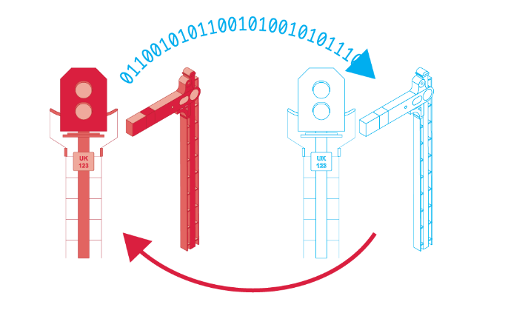
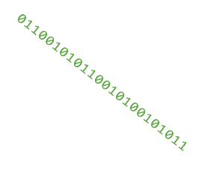
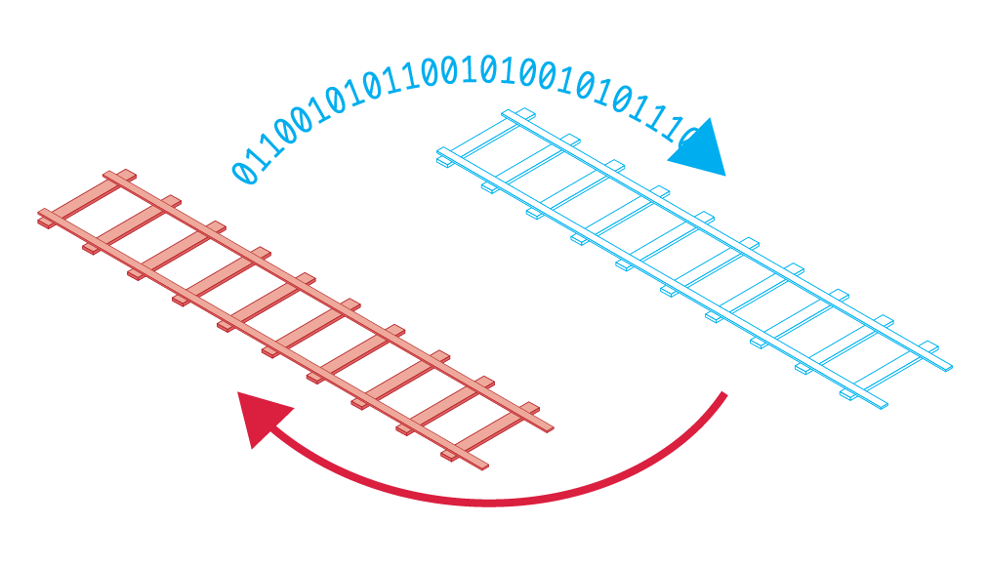
Connected digital twins
Copyright Centre for Digital Built Britain, on behalf of the Chancellor, Masters and Scholars of the University of Cambridge, 2021. All Rights Reserved.

Slide 17
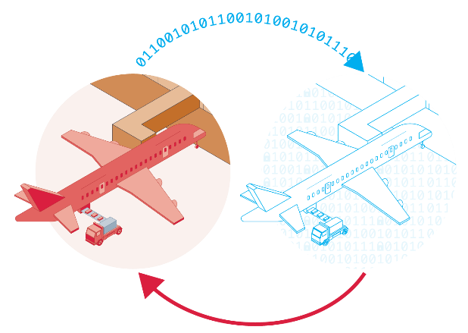
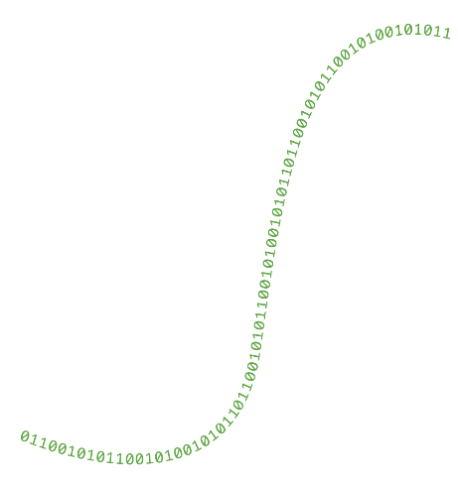
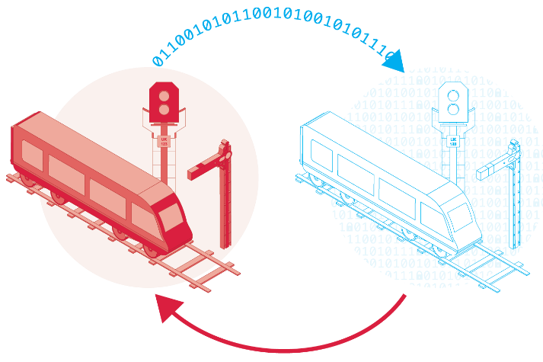
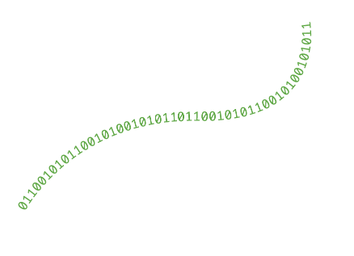
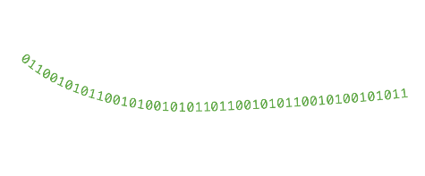
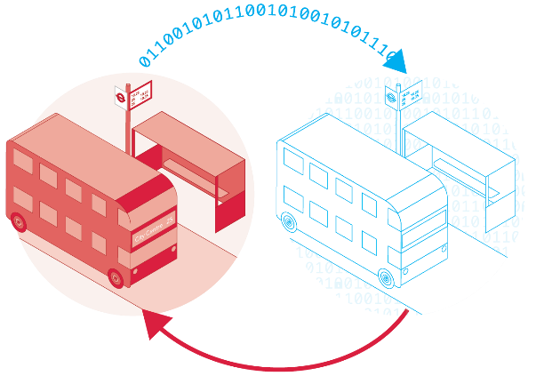
Ecosystem of connected digital twins
Copyright Centre for Digital Built Britain, on behalf of the Chancellor, Masters and Scholars of the University of Cambridge, 2021. All Rights Reserved.

Slide 18
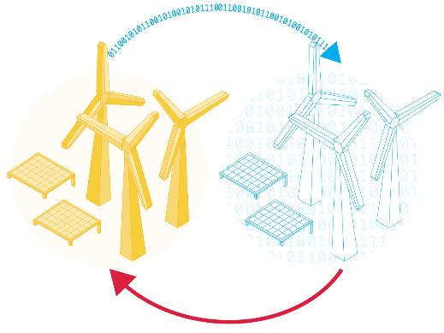
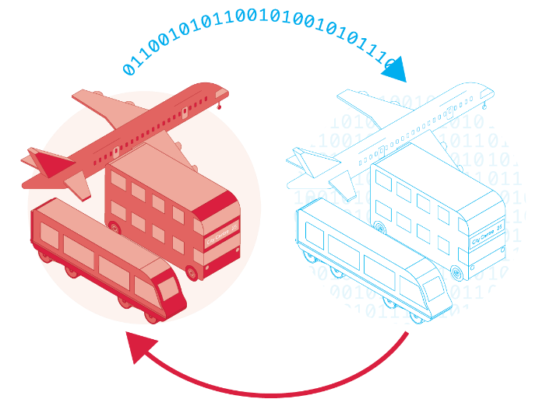
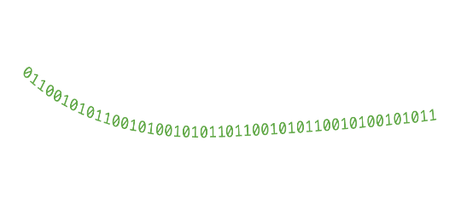
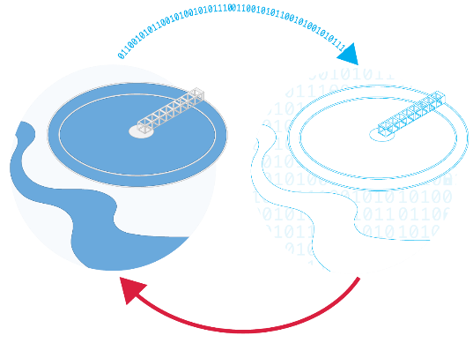
Ecosystem of connected digital twins
Copyright Centre for Digital Built Britain, on behalf of the Chancellor, Masters and Scholars of the University of Cambridge, 2021. All Rights Reserved.

Slide 19
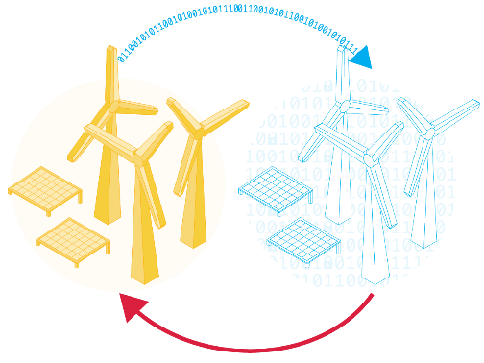
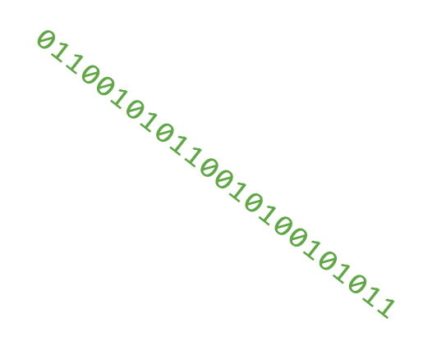
The National Digital Twin – a principled approach
Regulator
Copyright Centre for Digital Built Britain, on behalf of the Chancellor, Masters and Scholars of the University of Cambridge, 2021. All Rights Reserved.

Slide 20
The Information Management Framework
Information Quality Management
A consistent approach to data modelling
Shared reference data
Common security and access protocols
Process Model based Information Requirements
Integration Architecture
Industry Data Models & Reference Data
Foundation Data Model
Top Level Ontology
Core Constructional Ontology

Slide 21
The NDTp is a socio-technical change programme
Technical
Socio-technical
Copyright Centre for Digital Built Britain, on behalf of the Chancellor, Masters and Scholars of the University of Cambridge, 2021. All Rights Reserved.

Slide 22
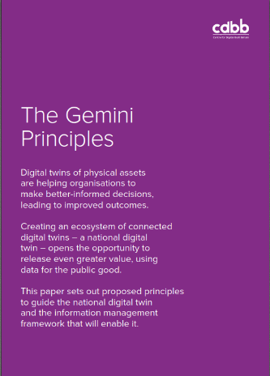
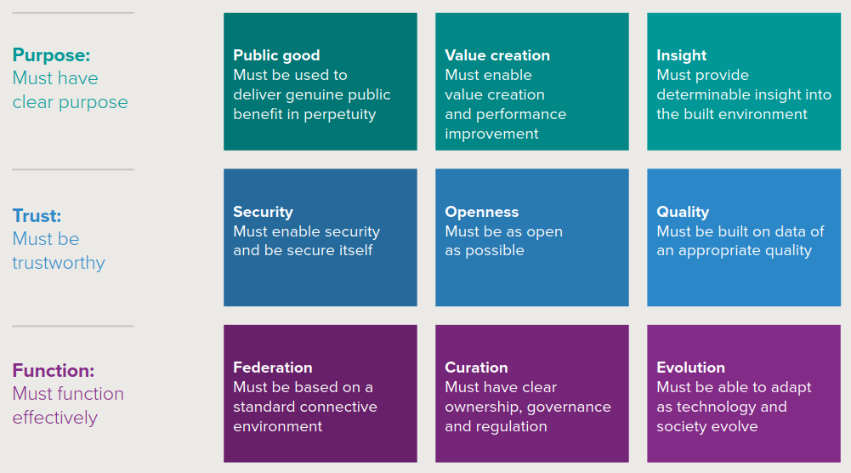
Driven by values
Copyright Centre for Digital Built Britain, on behalf of the Chancellor, Masters and Scholars of the University of Cambridge, 2021. All Rights Reserved.

Slide 23
Benefits of a National Digital Twin
Better decisions means better outcomes for people and society and nature
Benefits to society: Improved stakeholder engagement. Better outcomes for the ultimate customers (the public – taxpayers/bill payers/fare payers/voters). Improved customer satisfaction and experience through higher-performing infrastructure and the services it provides.
Benefits to the economy: Improved national productivity from higher-performing and resilient infrastructure operating as a system. Improved measurement of outcomes. Better outcomes per whole-life pound. Improved information security and thereby personnel, physical and cyber security.
Benefits to business: New markets, new services, new business models, new entrants. Improved business efficiency from higher-performing infrastructure. Improved delivery efficiency, benefiting the whole construction value chain – investors, owners, asset managers, contractors, consultants, suppliers. Reduced uncertainty and better risk management.
Benefits to the environment: Less disruption and waste. More reuse and greater resource efficiency – a key enabler of net zero and the circular economy in the built environment.
Copyright Centre for Digital Built Britain, on behalf of the Chancellor, Masters and Scholars of the University of Cambridge, 2021. All Rights Reserved.

Slide 24
The digital transformation of the built environment must be
Outcome-focused
Purpose-driven
Systems-based
Values-guided
Socio-technical

Slide 25
The planet is ultimate system of systems
We can make Our Vision a reality, but only if we all play our part with energy, coordination and purpose, making use of the advanced array of enablers that we now have at our disposal.

Slide 26
Thank you Build better connections: digitaltwinhub.co.uk
Copyright Centre for Digital Built Britain, on behalf of the Chancellor, Masters and Scholars of the University of Cambridge, 2021. All Rights Reserved.

