Slide 1



CReDo​: The National Digital Twin ​
Climate Resilience Demonstrator project​
Collaboration and resilience through connected digital twins

Slide 2

Kirsten Lamb
National Digital Twin programme
Centre for Digital Built Britain

Slide 3

Agenda
CReDo overview | Sarah Hayes
Findings and methodology | Tom Collingwood
Project model demonstration | Jethro Akroyd
The IMF and Credo | Matthew West Tom Burgoyne
Lessons learnt | Rachel Judson Holger Kessler
Interviews | Asset owners and project partner
Benefits Recommendations | Matthew Bell Sarah Hayes
Q&A | Panel
Final reflections | Mark Enzer

Slide 4
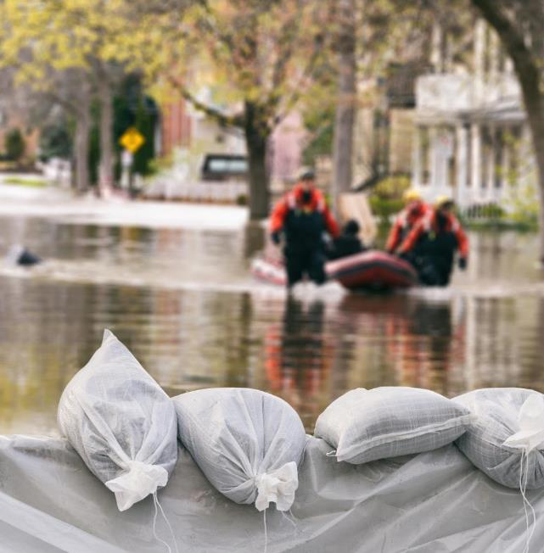
Housekeeping
Use Q&A function rather than the chat to ask questions
A recording will be shared publicly
Follow along and post your thoughts using #CReDo and #NDTprogramme

Slide 5
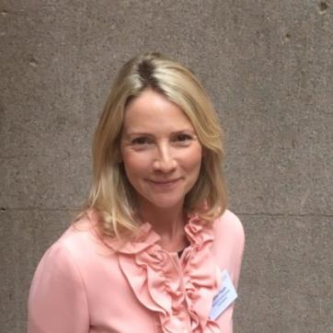
Sarah Hayes
CReDo Project Lead, National Digital Twin programme

Slide 6

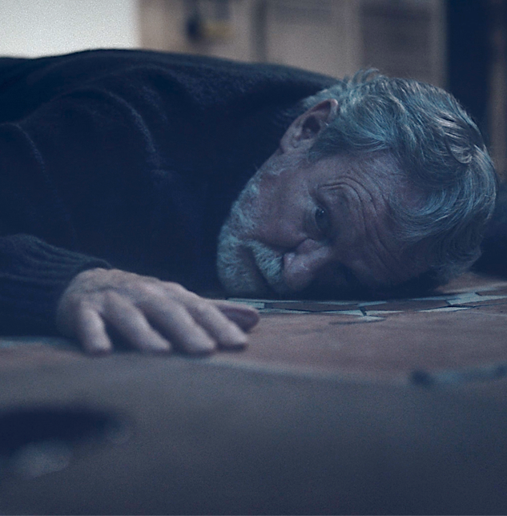
Tomorrow Today
Collaboration through connected digital twins is key to tackling climate change

Slide 7
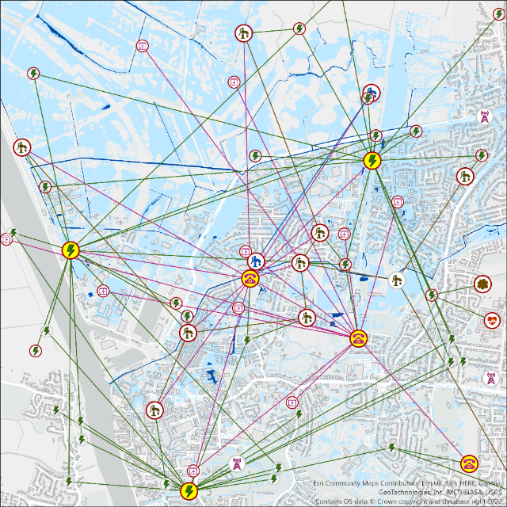
CReDo is a climate change adaptation digital twin
CReDo brings together data across energy, water and telecoms networks​
Anglian Water’s water and sewerage assets,
BT’s communication assets and
UKPN’s power network assets.
with flood data to understand
Infrastructure interdependencies
Asset failure and system impact
What can we do to prepare or respond?
How do we increase system resilience and adapt?

Slide 8
CReDo
CReDo
Asset owners + data
Legal
IMF
STFC
Benefits
Film
App
JCEEI flood data
Mott Macdonald
Research
CPC/
CMCL

Slide 9
CReDo outputs on the digitaltwinhub.co.uk in March 2022
Reports:
Building a digital twin
Generating flood data
Assessing asset failure
Understanding system impact
CReDo and the IMF (forthcoming)
Benefits report (forthcoming)
CReDo overview report (forthcoming)
Other resources:
Visualisation with synthetic data
Lessons learnt
Template data licence
Video presentations
Links to GitLab for synthetic data and source code
Project plan tasklist

Slide 10







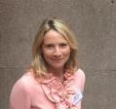


















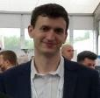
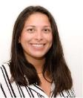
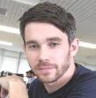






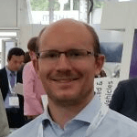
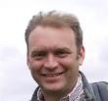








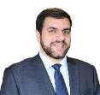












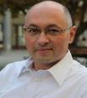







The CReDo team

Slide 11
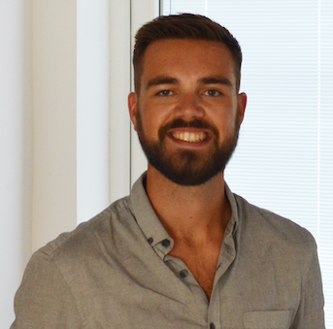
Tom Collingwood
CReDo Technical Architect, The Hartree Centre, Science and Technology Facilities Council

Slide 12
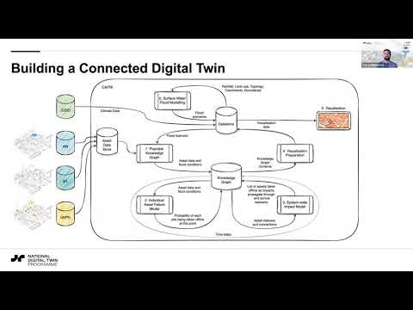

Slide 13
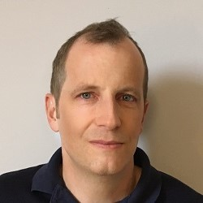
Jethro Akroyd
Principal Engineer, CMCL Innovations

Slide 14
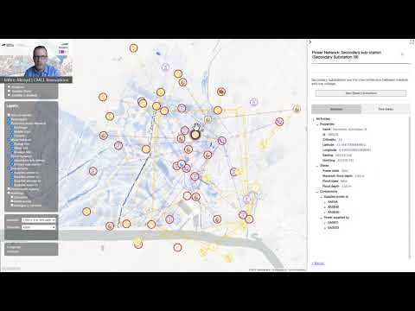

Slide 15
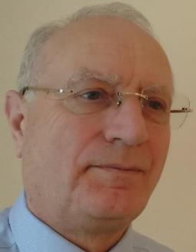
Matthew West
Information Management Framework Team Lead,
Information Junction

Slide 16
The information infrastructure that will unleash the information economy

Slide 17
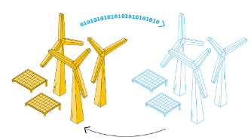
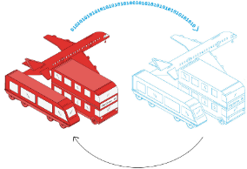
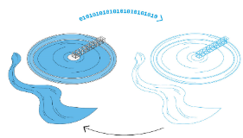



The vision
You are able to trust the quality of data that is shared just as you trust the quality of water when you turn the tap on

Slide 18

Information
Management
Landscape
Management
Policy/ Controls Framework
Governance
Strategy & Operating Model
Organization
What needs to be established by an organization for the efficient sharing of data.
Plans, Justification & Risk Mgt
Roles and Responsibilities
Information Operations
Key Performance Indicators
Process Model based Information Requirements
Communications
Integration Architecture
Industry Data Models & Reference Data
Application Portfolio
Foundation Data Model
IM Community
Top Level Ontology
Core Constructional Ontology
IT Support
Knowledge Management
Training
Support

Slide 19

Information Management Framework
Information Management Framework
The standards, guidance, and common resources to support the development of consistent Information Management Landscapes that can seamlessly share data
Management
Policy/ Controls Framework
Governance
Strategy & Operating Model
Organization
Plans, Justification & Risk Mgt
Roles and Responsibilities
Information Operations
Key Performance Indicators
Process Model based Information Requirements
Communications
Integration Architecture
Industry Data Models & Reference Data
Application Portfolio
Foundation Data Model
IM Community
Top Level Ontology
IT Support
Core Constructional Ontology
Knowledge Management
Training
Support

Slide 20
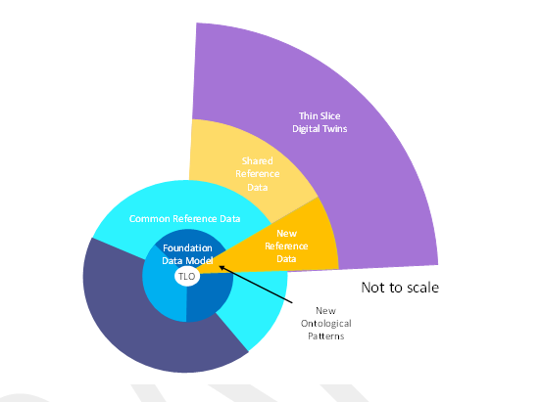
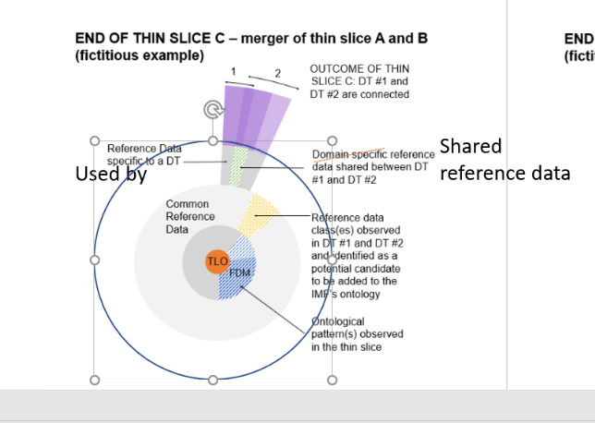
The thin slice approach
Tom Burgoyne will be talking about the Anglian Water thin-slices next
Thin-slice Digital Twins
Shared Reference Data class(es) that are part of or to be added to the IMF ontology
Shared reference data
Common Reference
Data
Common Reference Data such as units of measure that are part of the IMF ontology
ontological pattern(s) (FDM)
FDM
TLO
Top-Level Categories

Slide 21
Achievements & learnings
Achievements
a number of thin slices have been developed through CREDO with Anglian Water data (demonstrates that the methodology works)
Learnings
Importance of data sharing agreement for collaboration
Importance of organisational readiness to implement thin slices

Slide 22
Next steps
Continue developing the Foundation Data Model and Reference Data Library through thin-slices
Develop the Integration Architecture open-source software to support implementation
Instigate work towards standard data sharing agreements for a variety of use cases to make achieving appropriate data sharing agreements easier and faster
Develop methodology for assessing benefits of improving the quality of information by applying the Information Management Framework

Slide 23
Thank You

Slide 24
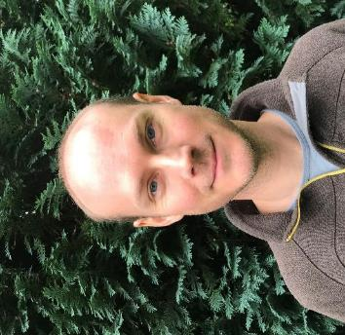
Tom Burgoyne
Enterprise Data Architect, Anglian Water Services

Slide 25

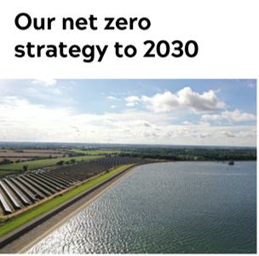
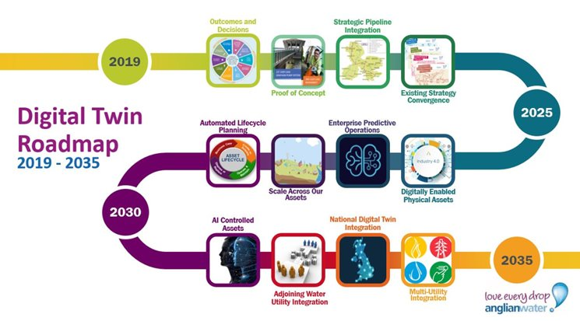
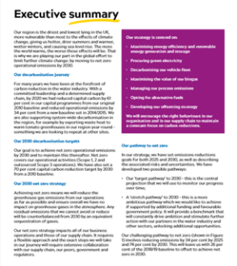
Anglian Water Context​
The intersection between our Digital Transformation and Net Zero Carbon strategies

Slide 26
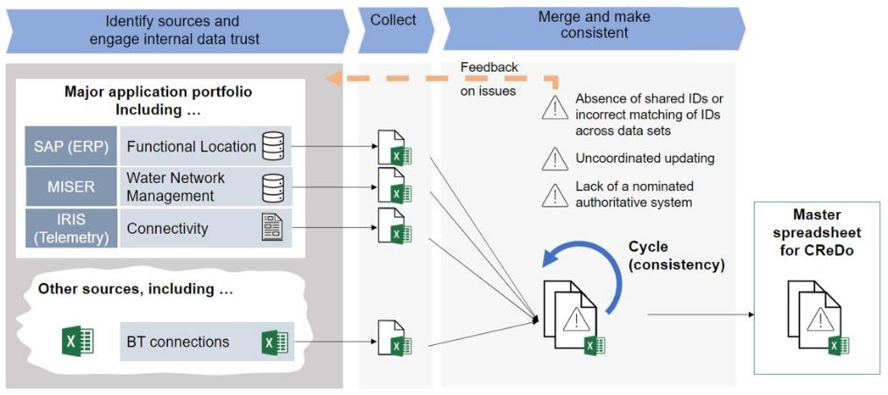
The Pragmatic Approach​
The traditional response to a data request where quick turnaround is required​

Slide 27
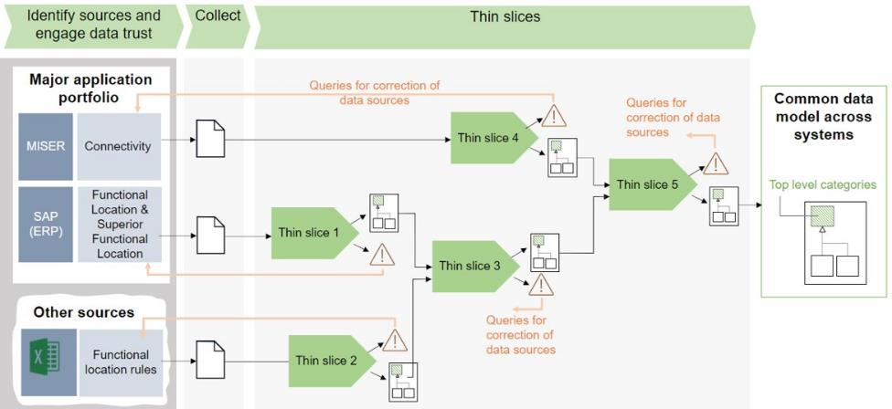
The IMF Approach​
Information Management Framework's guidance on a more reusable approach​

Slide 28
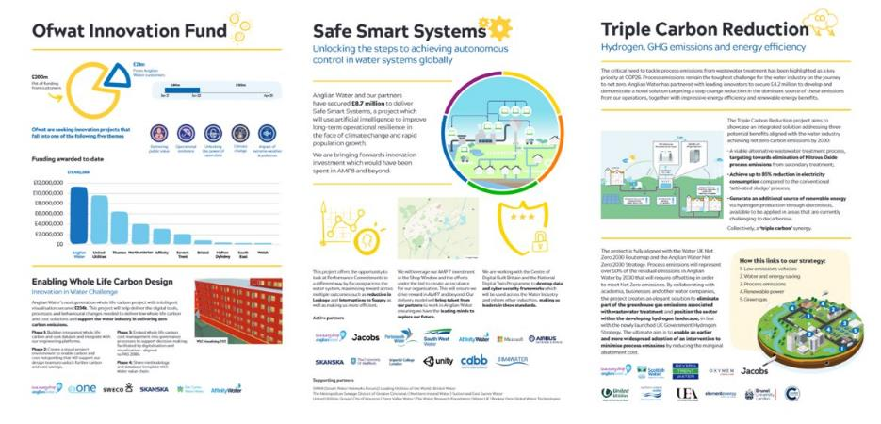
Anglian Water Future​
Developing an Information Management Landscape for the Water Industry​

Slide 29
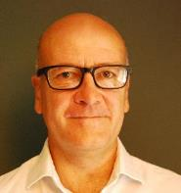
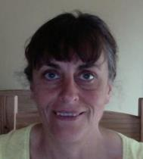
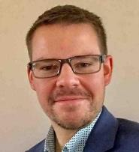
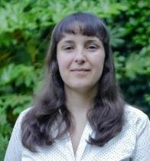
Joining us next are:
 | Richard Buckingham Climate Change and Carbon Manager, Anglian Water Services
 | Louise Krug Research Manager Sustainability, BT
 | Matt Webb Head of Enterprise Data, UK Power Networks
 | Yalena Coleman Solutions Architect, Connected Places Catapult

Slide 30
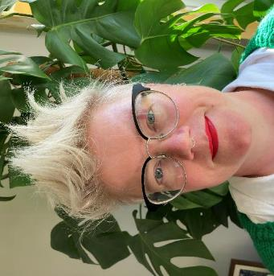
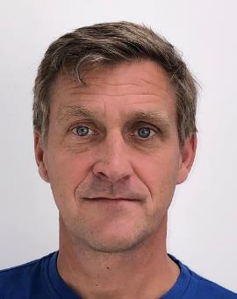
Rachel Judson
CReDo Project Manager,
National Digital Twin programme
Holger Kessler
Geospatial Commission​
NUAR Stakeholder and Comms Lead
Notes:
Thank you for joining us today, Holger.
As this first phase of Credo draws to a close, we have been reflecting on the things we have learnt and how others might benefit from them. ​
The Credo project seeks to bring together sensitive asset data from across industry sectors to build a connected digital twin to provide insight into infrastructure interdependencies and allow collaborative decisions to maximise resilience across the whole system​.
We see similarities between CReDo and the work undertaken by the Geospatial Commission on the National Underground Asset register, or NUAR, and would like to take some time today to look at those. Holger, would you mind giving a summary of the NUAR project for those not familiar?

Slide 31
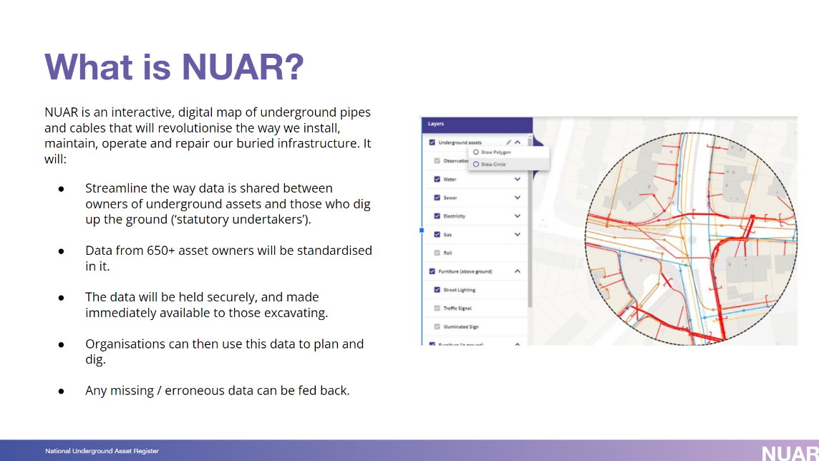
Notes:
Thank you for joining us today, Holger.
As this first phase of Credo draws to a close, we have been reflecting on the things we have learnt and how others might benefit from them. ​
The Credo project seeks to bring together sensitive asset data from across industry sectors to build a connected digital twin to provide insight into infrastructure interdependencies and allow collaborative decisions to maximise resilience across the whole system​.
We see similarities between CReDo and the work undertaken by the Geospatial Commission on the National Underground Asset register, or NUAR, and would like to take some time today to look at those. Holger, would you mind giving a summary of the NUAR project for those not familiar?

Slide 32
CReDo Lessons Learnt
Discovery
Communication
Data & Security
Notes:
Thank you, Holger.​
When we looked at the Lessons Learnt for CReDo we found 3 themes that really stood out; [run though the following 4 cumulative slides]​

Slide 33
CReDo Lessons Learnt
Discovery
Communication
Data & Security
An extended discovery period
Data scoping with asset data providers and availability of suitable data models
Notes:
The Credo project was only funded for 12 months, which makes for a very ambitious timeline!
The project required a lot of discovery work;
Discovery of the data Credo required
Discovery of the data the Asset owners could source and share
Availability and suitability of climate and flood data
All of this took time, which put pressure on the time available for development.

Slide 34
CReDo Lessons Learnt
An extended discovery period
Data scoping with asset data providers and availability of suitable data models
Defining the data required.
Understanding the security required to enable the sharing of data.
Understanding where to hold the data, how to work with the data, and who would have access to it.
The data exploration licence that protected the arrangement.
Discovery
Communication
Data & Security
Notes:
Once the data had been identified, we had to understand;
the security that would be required to store that data,
who would need to access to work with it.
We worked with the CReDo Asset owners and with the STFC (Science and Technology Facilities Council) and DAFNI (Data and Analytics Facility for National Infrastructure) to set up a Data Exploration Licence that was subsequently signed up to by each of the CReDo consortium members and participants.
WE still have more to learn about the best way to set up these data licences, how to enable other parties to sign up, and what the impact of restrictive licences have when it comes to using date derived from sensitive asset data. This is an area where we could learn from NUAR and from other legal arrangements, such as data trusts.

Slide 35
CReDo Lessons Learnt
An extended discovery period
Data scoping with asset data providers and availability of suitable data models
Discovery
Communication
Data & Security
Defining the data required.
Understanding the security required to enable the sharing of data.
Understanding where to hold the data, how to work with the data, and who would have access to it.
The data exploration licence that protected the arrangement.
Develop set of synthetic data to facilitate discussion with internal and external stakeholders.
Build comms collateral to demonstrate and explain technical delivery.
Regular, engaging and open communications across stakeholders.
Notes:
As with all projects Communication has been key to Credo.
You may well remember, at our last webinar in November, we premiered the Credo film, Tomorrow, Today and the app describing Storm Ruby. Both have been very helpful when talking about and demonstrating the project motivations and aims. Being able to illustrate a complex technical process and make it real has been essential.
Central to this has been the creation of a set of synthetic data, that has enables us to create, test model, demonstrate and communicate outside the restrictions of the data licence. The Synthetic Data will be available as part of the Credo Legacy on the DT Hub by the end of this month.
Holger, what do you think are the most important learning points that others should be aware of if they are looking to get started on their own connected digital twin project like CReDo or NUAR?

Slide 36
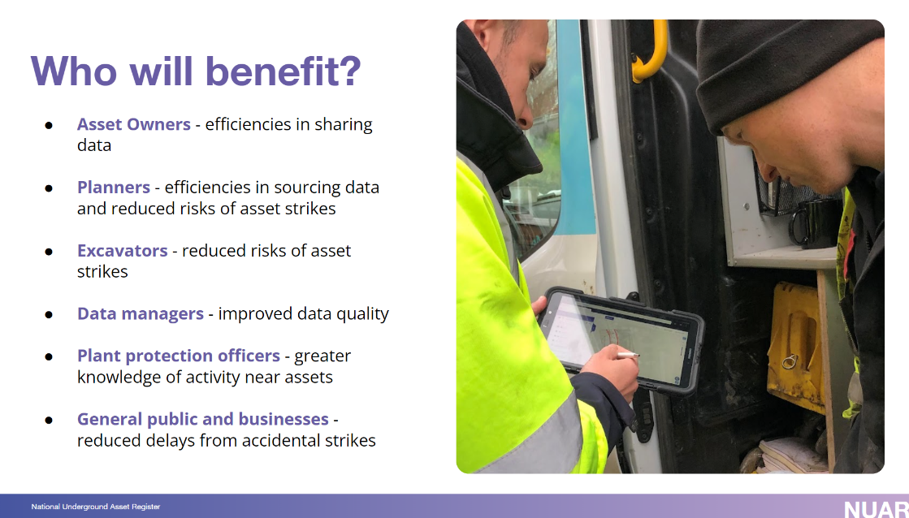
Notes:
Now that NUAR is in its next phase, what advise would you give to those, and I would include any future CReDo phases here too, who are looking to continue or expand their digital twin?​
Have you had to re-address the security or data sharing agreements for the Build Phase?​
(Keep focus on users and use case, build a community, find the champions, build on successes and learn from failures – then scale, build a firm business case and deliver value early.​
Security is KEY, yes data sharing agreements have been a challenge but we have found consensus!)

Slide 37
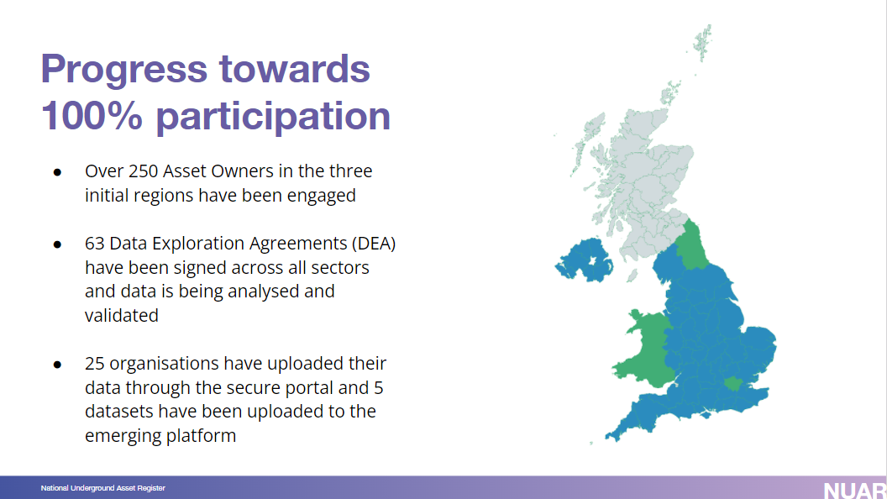
Notes:
Thank you so much, Holger, for joining us today and sharing your experience with NUAR so far and we wish you all the very best on this new phase.​
Details about NUAR can be found on the Geospatial Commission’s gov.uk pages and we will post the link in the chat. For CReDo, our lessons learnt will be published on the DT Hub in the coming weeks as part of the project resources. We hope that you find them useful.​
Thank you. Kirsten, back to you.

Slide 38
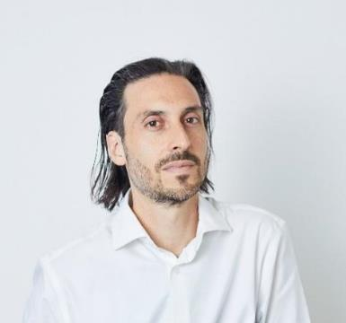
Matthew Bell
Director, Frontier Economics

Slide 39







What is the expected impact of CReDo?
Asset operators
Residential and business customers
Wider society
Flood resilience
Information Management Framework (IMF)
Spillover impacts

Slide 40
What is the expected impact of CReDo?
Flood resilience
Information Management Framework (IMF)
Asset operators
More efficient/effective investment
More efficient/effective response
Lower repair costs and regulatory penalties
More efficient/effective to share information within and between organisations
Better decision making
Residential and business customers
Fewer disruptions
Smaller loss of income/revenue
Avoided injuries
Better decision making may result in:
Improved quality of service
Increased value for money
Spillover impacts
Improved modelling and forecasting capabilities (e.g. hydrology, climate change models)
Open data
Help developers planning for new housing
Wider society
Increased resilience of supply for essential infrastructure
Improved understanding of infrastructure interdependencies
Inward investment
More efficient to scale digital twins
Improved collaboration across sectors
Social and environmental benefits

Slide 41

How do you quantify the expected impact?
Our modelling approach
Focus: expected impacts on flood resilience for asset operators and their customers
Time horizon: 2050
Geography: selected area in East Anglia
Flood scenario: a severe surface water flood
Counterfactual: individual digital twins
£
CReDo
Counterfactual
today
2050
Main output: a report at end of March
Assessment of expected benefits
Quantification of expected impact of increasing flood resilience

Slide 42
Sarah Hayes
CReDo Project Lead, National Digital Twin programme

Slide 43
CReDo philosophy: “Make it work, then make it better”
Start small
Focus on single use case
Add complexity

Slide 44
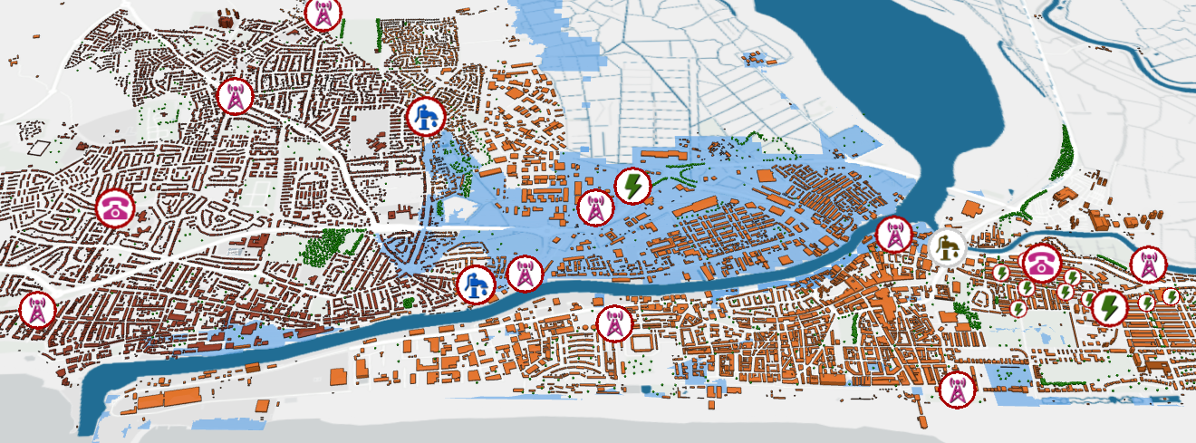
Visualisations help: Sunford City – at the end of Storm Ruby

Slide 45
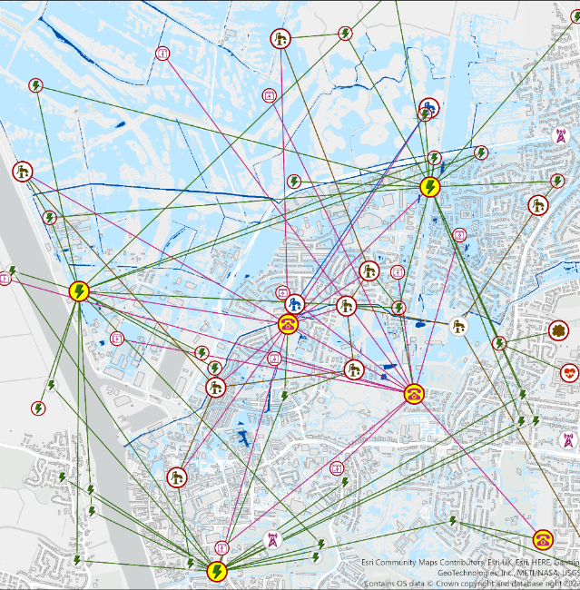
Synthetic data snapshot
Key interdependencies
Extent of failure
Homes at risk
Hospital status

Slide 46
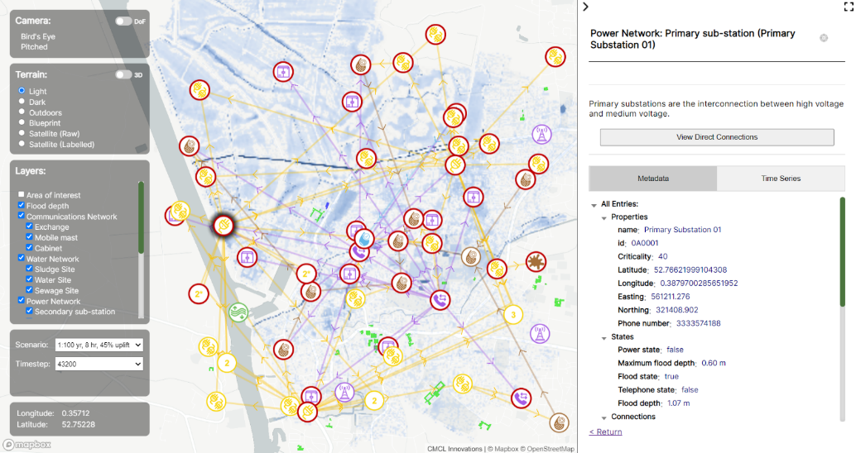
Visualisation with synthetic data on DT Hub

Slide 47

Recap
Purpose and collaborative intent are essential
Shared data can highlight anomalies and offer immediate insights
Ontologies help with scaling up and knowledge graphs support ontologies
Recommendations
www.digitaltwinhub.co.uk

Slide 48
CReDo future steps – for consideration
Investigate how to share updated data securely to support live data connections
Extend the digital twin to include:
    Roads and access
    Other coincident factors eg wind
    Other use cases eg extreme heat
    Further complexity on system propagation (criticality, customers impacted, recovery, interventions)
Greater geographical coverage (other asset owners across UK)
Could you create your own CReDo?

Slide 49
Most importantly, get the right team in place

Slide 50
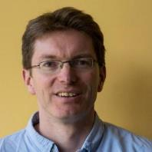
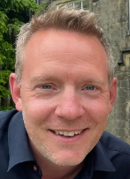

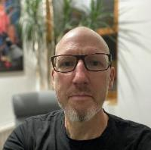
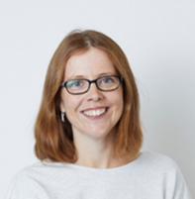
Joining the panel for Q & A:
Chris Dent
CReDo Technical Lead,
University of Edinburgh
Matt Edwards
Chief Data Officer, Anglian Water
Ben Mawdsley
Credo Technical Architect,
The Hartree Centre, STFC
Robin Pinning
The Hartree Centre, STFC
Sarah Snelson
Frontier Economics

Slide 51
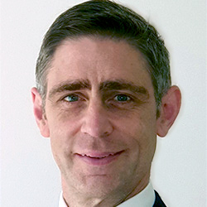
Mark Enzer, OBE
Director, Centre for Digital Built Britain
Head of the National Digital Twin programme
Chief Technical Officer, Mott MacDonald

Slide 52
digitaltwinhub.co.uk/projects/credo
#CReDo #NDTprogramme

