Slide 1


UK Government policy and why interoperability is so important (GIIG)
The Government’s Construction and DDaT Playbooks, and the TIP Information Management Mandate
Notes:
We are all information managers – Good Information is the foundation of every effective decision we make
GIIG is not about standards and policy, but about how to – the practical delivery of information management (not my expertise but talk to the GIIG team on stand A63)

Slide 2

UK Built Environment: The Case for Digitisation
Delayed and cancelled infrastructure spending in 2015/16 cost the UK economy £6bn
Traffic congestion cost the UK economy £31bn in 2016
Train delays in the UK cost the economy over £1bn annually
Up to 20% of total construction costs are for re-work
Homes and offices consume up to 4x more energy usage than designed
It costs the NHS £600m pa to treat illnesses caused by living in poor housing conditions in England
The built environment contributes c40% of the UK’s total greenhouse gas emissions
Disruption from flooding costs the UK economy £1bn pa
Notes:
Cost issues remain highly pressing – tender prices currently highly volatile.
More reliable data helps us respond appropriately to highly fluid situations

Slide 3




Information management (using BIM) and digitisation are central to Government’s approach – driving improvements across construction supply chain
Productivity
Design: BIM, Rapid Engineering Modelling, object libraries and configurators
Industrialisation: manufacturing built assets, automation, robotisation
Skills: building digital capability
Improved Operations
Supply chain integration: better logistics, payment and contractual management
Asset optimisation: interconnected systems, data sharing
Culture Change
Collaboration: improved transparency and information flows within supply chains
Quality: management systems and defect prevention
Safety: Golden Thread of building safety information, site environments, occupational and mental health
Notes:
What is increasingly important is what happens next – Net Zero Carbon, NDTp, etc - building on these foundations

Slide 4
Construction Playbook: changing the relationship between Government and the construction sector
The Construction Playbook aims to:
Reset the relationship with the construction sector to make this more strategic and less transactional
Increase the speed of end-to-end project and programme delivery
Embed delivering best value at the heart of government procurement of construction
Drive innovation and the adoption of Modern Methods of Construction – including product platforms with standardised designs, components and interfaces
Create longer term, sustainable, effective, and fairer contracting arrangements
Deliver greater social value
1 | Publication of commercial pipelines
2 | Portfolios and longer term contracting
3 | Harmonise, digitalise and rationalise demand
4 | Market health & capability assessments
5 | Early supply chain involvement
6 | Outcome-based approach
7 | Further embed digital technologies
8 | Should Cost Models and benchmarking
9 | Delivery Model Assessments
10 | Risk allocation
11 | Pricing & payment mechanisms
12 | Effective contracts
13 | Assessing the economic and financial standing of suppliers
14 | Resolution planning
Notes:
Mention other playbook(s) – the ‘playbook’ concept/purpose: to choreograph the responses needed to a situation
Comment on direction of the new Construction Playbook (climate change requires joined-up whole life thinking through procurement, delivery to operational asset management)
Through to end of life (nuclear decommissioning example)

Slide 5

Information management (using BIM), data and digital are central to the Construction Playbook
‘comply or explain’ guidance to UK government departments and arms-length bodies on procuring public works projects and programmes.
Strongly outcomes focused (82 mentions); “whole life” mentioned 23 times
aims to improve safety, cost, speed and quality of delivery, upskill the workforce and promote “greater sharing of better data” (Introduction, p.3).
Endorses the UK BIM Framework:
  “Contracting authorities should use the UK BIM Framework to standardise the approach to generating and classifying data, data security and data exchange …” (p.3)
Notes:
Maybe reference to Simon Lewis talk later in the morning of DCW day one on procuring for interoperability

Slide 6
Focus on whole life value, and an outcomes-based approach, central to DDaT Playbook
“Mandated for central government departments and arm’s-length bodies (ALBs) on a ‘comply or explain’ basis and … expected to be taken into account by the wider public sector …” (p.9)
Strongly outcomes focused (104 mentions); “whole life” also mentioned 18 times
13 references to interoperability
“Focus on whole-life value” and “focusing on user needs, not specific solutions” (Foreword, p. 1)
“Avoid being ‘locked into’ a supplier’s solution: … requirements should be drafted to be supplier or technology agnostic” (Commercial considerations, p.47)
Notes:
The DDaT Playbook shows a similarly consistent approach to the Construction Playbook
same purpose, audience
same outcomes and whole life focus
stressing on user information requirements not technologies

Slide 7
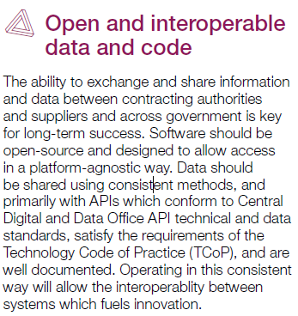
DDaT Playbook stresses open, interoperable data and code
Notes:
The DDaT Playbook features 11 key policies, including one specifically focused on “open and interoperable data and code” It stresses …
“The ability to exchange and share information and data between contracting authorities and suppliers and across government is key for long-term success.
Software should be … “platform-agnostic” and
“interoperability … fuels innovation”

Slide 8
Ch. 8: Designing effective contracts with common data standards
Digital, data and technology considerations (pp.56-62):
Legacy IT and up-to-date products
Intellectual property (IP)
Cyber security risk
Open and interoperable data and software
API technical and data standards
Contractual terms and conditions for cloud
“Open standards have long been a priority for government…
“… where possible, contracting authorities should ensure data is provided in open, machine-readable formats … .” (p.61)
“data … should be able to be easily exchanged across platforms to make efficient use of the data we own. …
ensure that all contracts … enable data extraction in a common format … to ensure accessibility and transparency.” (p.61)
Notes:
Chapter 8 of the DDaT Playbook specifically covers contracts and common data standards, and talks about open and interoperable data and software.
It highlights that, where possible, contracts should require data in open, machine-readable formats
that data should be able to be easily exchanged across platforms, and
that software should enable data extraction in a common format with appropriate regard to accessibility and transparency

Slide 9

Interoperability turns data into information
The ability to exchange and use information securely, ensuring that information is independent of the technologies used to deliver it.
Since 2011, UK Government has aspired to be able to easily exchange open, shareable asset information.
  Information to help design and manage the asset, and record changes to it
  Structured information exchanged across the contract line to facilitate a smooth handover
  Information to support operations during the whole asset lifecycle
  Information held in audit trails – ensuring regulatory compliance
  Information that can be exchanged with other assets
As of 2021, interoperability is now explicitly highlighted as a key requirement in UK Government construction strategy (expressed in the Construction Playbook and the TIP Roadmap 2030).
Notes:
This is about moving beyond digitising analogue processes (document management) to becoming data-centric (beyond files)
GIIG definition of interoperability focuses information
Important that technologies serve data – not about data sustaining the technologies
UK Government (CDDO, Make better use of data, March 2021) advice: “Make sure your data is not dependent on the lifecycle of your technology or service.“
(or the lifecycle of the company providing the technology, etc)

Slide 10
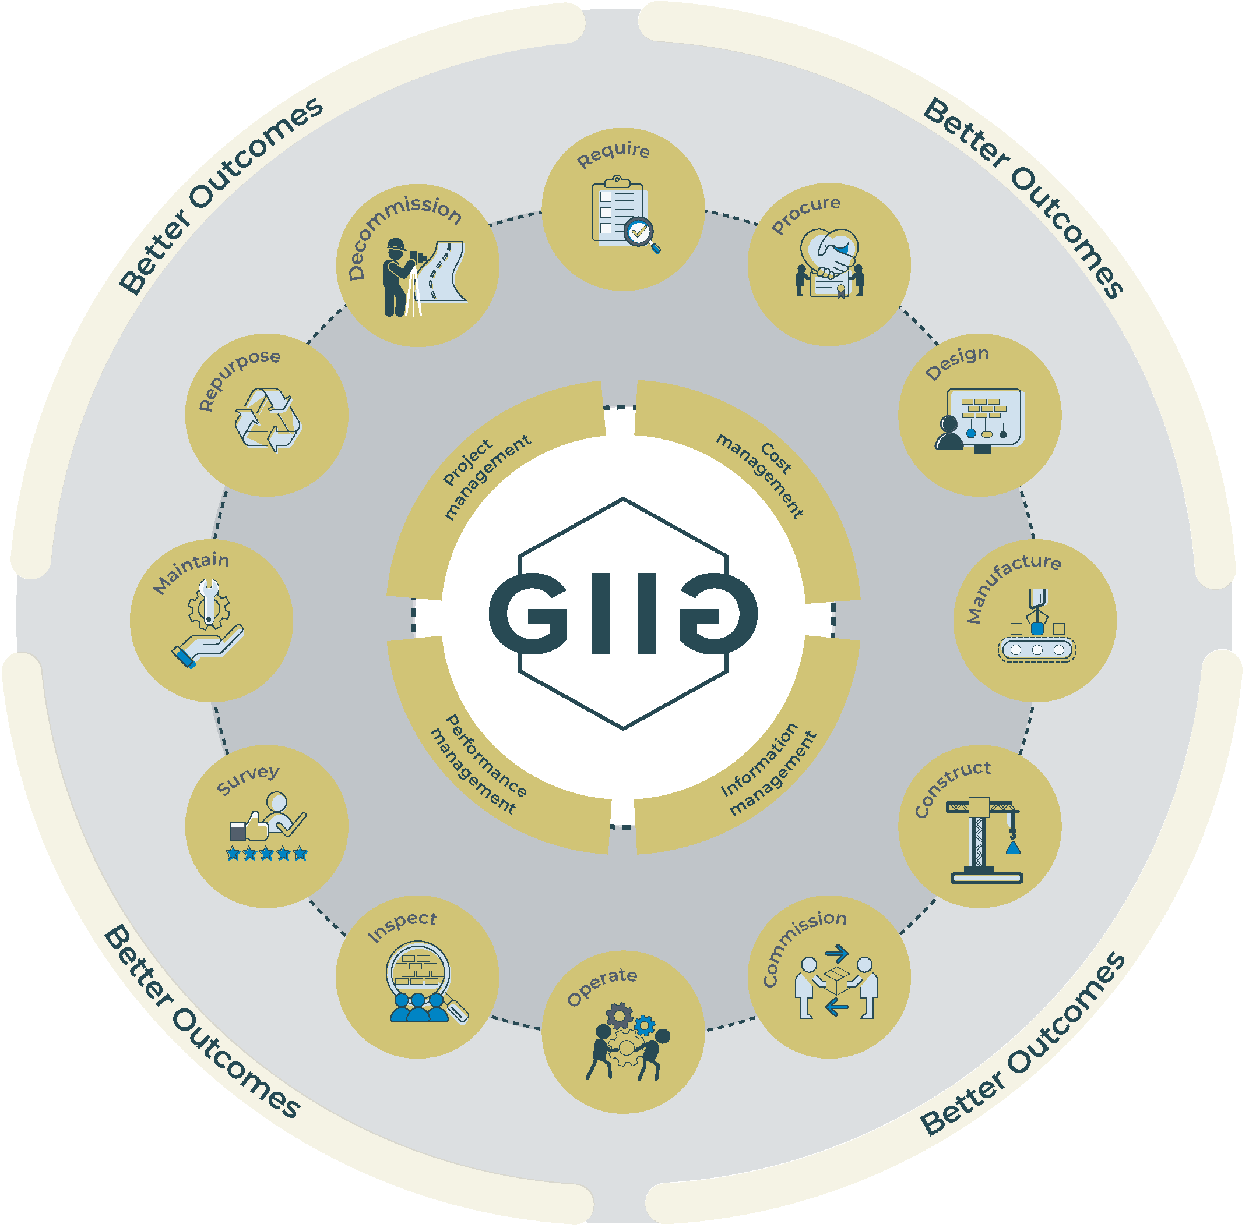
GIIG will drive the delivery of interoperable information across the asset lifecycle
Notes:
Practical information management underpins all the processes outlined in the Construction Playbook.
The energy of the BIM Task Group is now continued through the GIIG (strategic direction vs practical ‘how to’, respectively)
In the next mainstage presentation, Fiona will talk more about the workstreams – focus is on practical outputs to improve interoperability of information across the whole asset life cycle

Slide 11

Technologies Code of Practice for Interoperable Information
A Code of Practice is being introduced to address challenges posed by poor interoperability, and provide recommendations to technology providers, and to buyers and users of technologies.
Briefing for exhibitors and other technology providers to learn more about the initiative: DCW, 19 May 2022, arrive from 8am;
presentation and discussion 8.30-9.30am
To help shape the TCoPI, the GIIG has created a 3-minute Call for Evidence online survey – https://tiny.cc/GIIGCoP
The survey includes options to:
express interest in joining TCoPI working group
be consulted about the draft TCoPI
receive further GIIG communications
Notes:
The GIIG is looking to embed emerging good practice in a Code of Practice for Interoperable Information – DCW Day Two Breakfast briefing: Paul Wilkinson
Practical example of where government agency is applying information-centric thinking – DCW Day Two 0945: Graeme Tappenden on Information management platform (IMP), functional requirements, including Environment Agency case study

Slide 12
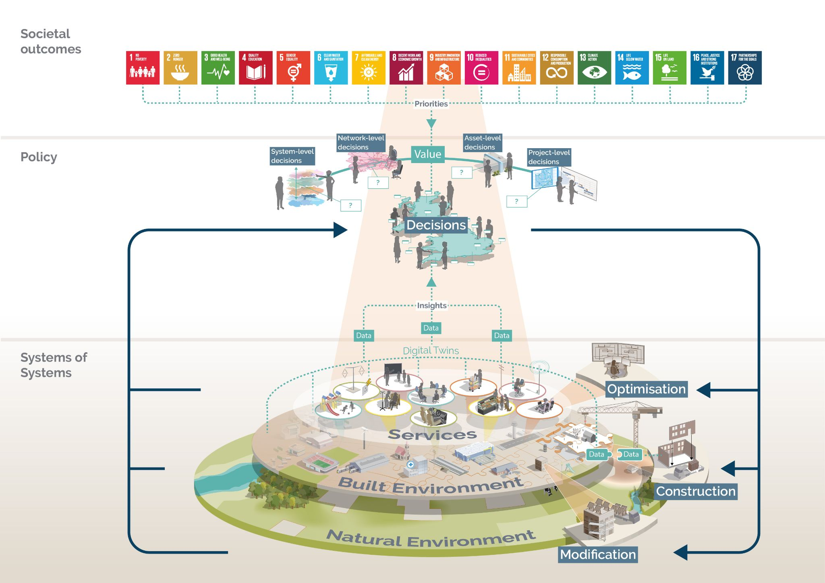
The Vision for the Built Environment
Notes:
Useful to sum up
Priorities – central is value (economic circumstances) – drives decisions on best whole life value / better outcomes
Whatever the political/economic/environmental situation, better information management will help us deliver a better response
Good Information is be the foundation for every effective decision we make

